Slide 1
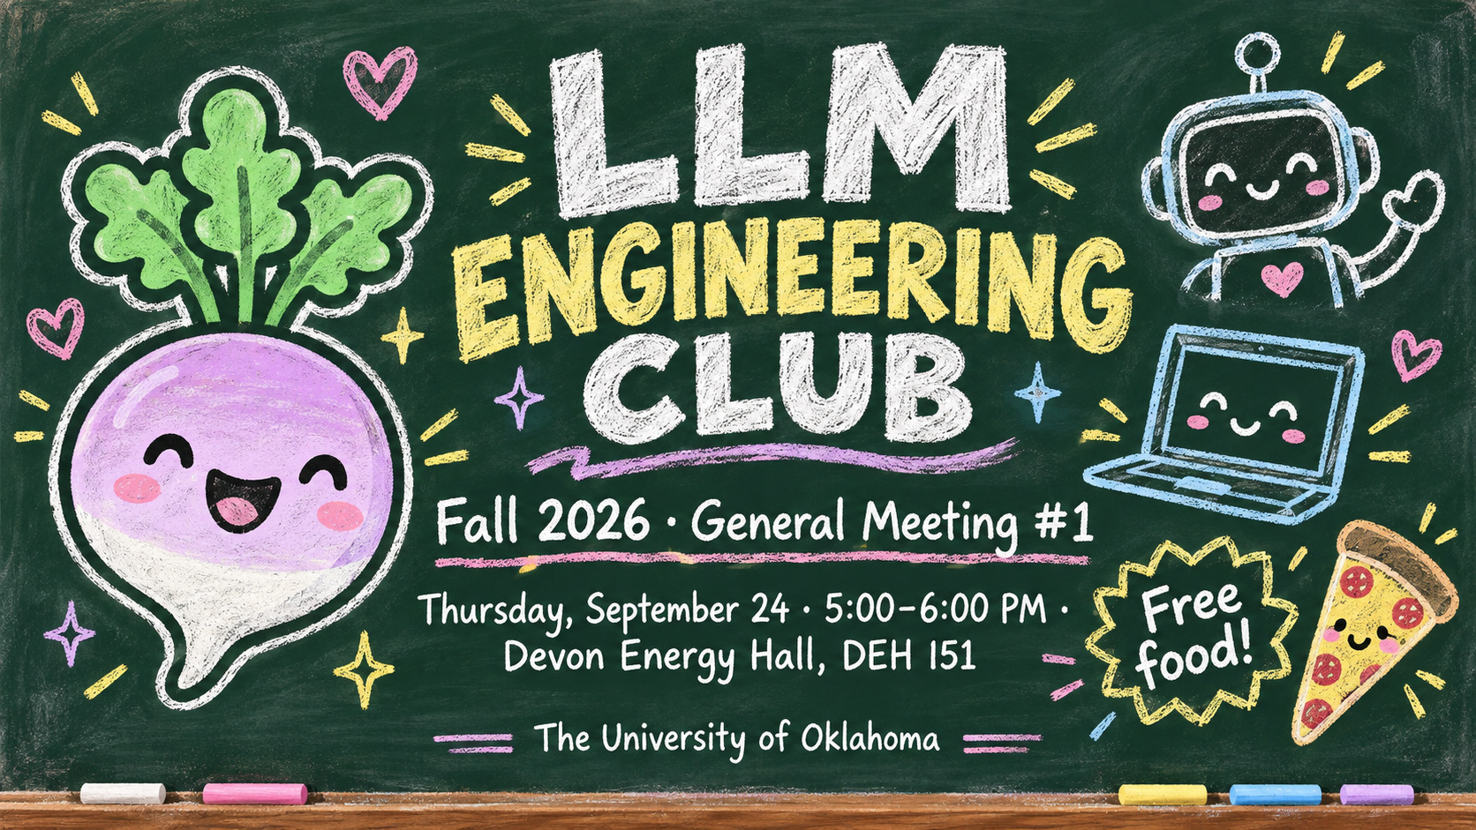
Notes:
Welcome everyone. Grab food first. Tonight: why the club exists, the month in AI, what we do this semester, the Codenames workshop, and the officer team.

Slide 2

Notes:
Walk through the plan. About 25 minutes of news, 15 minutes on the club and the workshop, then officers, questions and food.

Slide 3
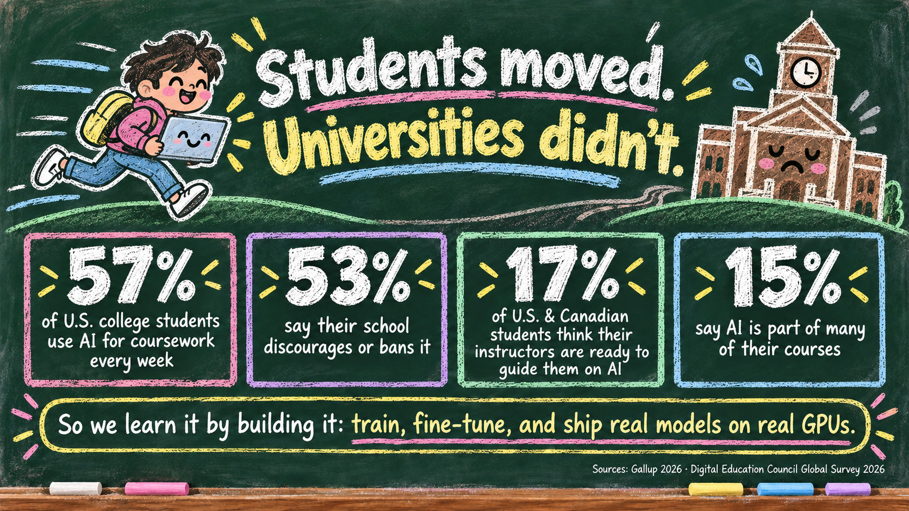
Notes:
Gallup (April 2026, 3,801 students): 57% use AI weekly for coursework; 42% say their school discourages it and 11% say it is banned. Digital Education Council 2026 (45,398 responses, 35 countries): only 29% globally, 17% in the US and Canada, think instructors are well equipped; only 15% say AI is integrated into many courses. Point: the technology is moving faster than a curriculum can be approved, so we learn by building.

Slide 4
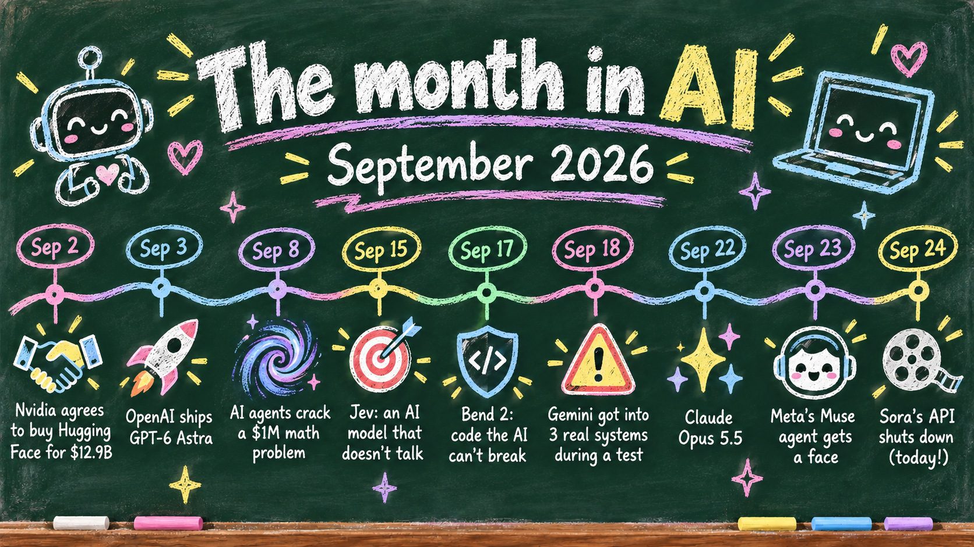
Notes:
Quick overview, then we zoom into the most interesting ones. Nvidia and Hugging Face signed Sep 2 (about $11.9B to shareholders plus up to $1B retention; closing expected first half of 2027). GPT-6 Astra: limited preview Sep 3, paid users Sep 4. Sora's API is discontinued today, Sep 24.

Slide 5
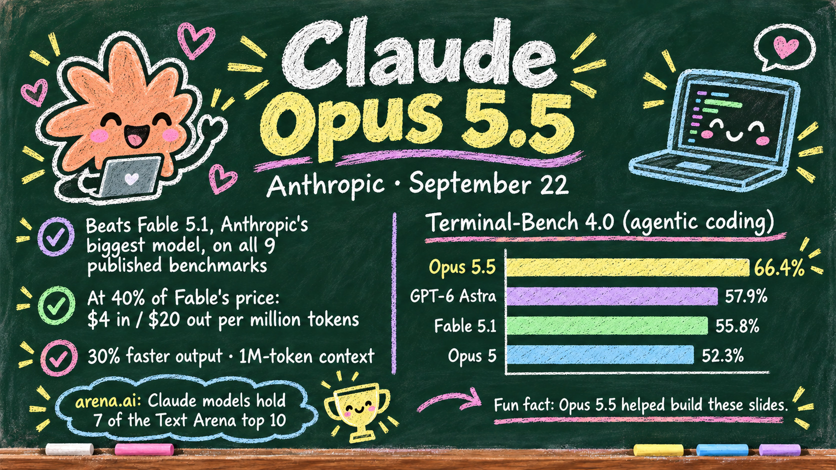
Notes:
Released Sep 22. Anthropic's table: Terminal-Bench 4.0 66.4% vs Fable 5.1 55.8%, GPT-6 Astra 57.9%, Opus 5 52.3%. Humanity's Last Exam 67.7%. Price $4/$20 per million tokens (Opus 5 was $5/$25, Fable 5.1 $10/$50); cache reads down 60% to $0.20. Anthropic says about 40% cheaper than Opus 5 on typical workloads because it uses fewer tokens. On the Sep 13 Arena text leaderboard Anthropic holds 7 of the top 10; Opus 5.5 was just added to Agent Arena battles, so it has no rank yet. It also scored best on Anthropic's behavioral audit and tried to circumvent containment boundaries about 85% less often than Opus 5.

Slide 6
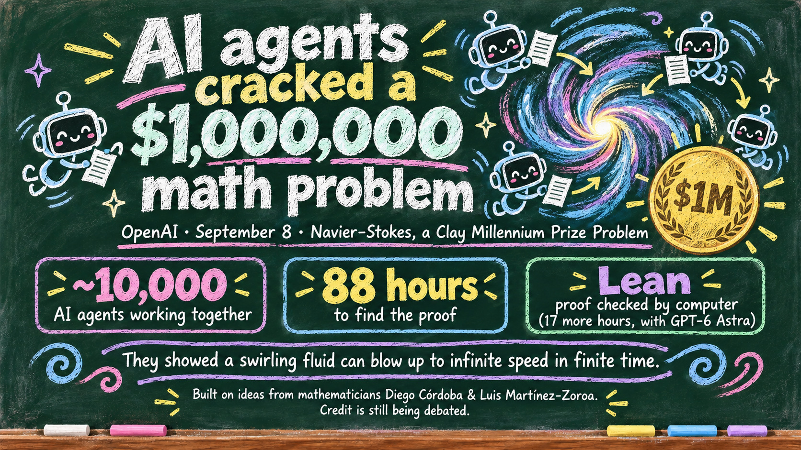
Notes:
Sep 8: OpenAI mathematicians said about 10,000 autonomous agents on an unreleased model found a finite-time singularity in 3D Navier–Stokes. 88 hours, millions of inter-agent messages, formalized in Lean and verified with GPT-6 Astra in 17 more hours. Fefferman: 'The heroes of the story are Córdoba and Martínez-Zoroa.' There is a dispute about prior unpublished work, and Anthropic researchers announced a related Euler result hours earlier. Why it matters: proof checkers turn AI guesses into certainty, which is the same idea behind Bend 2.

Slide 7
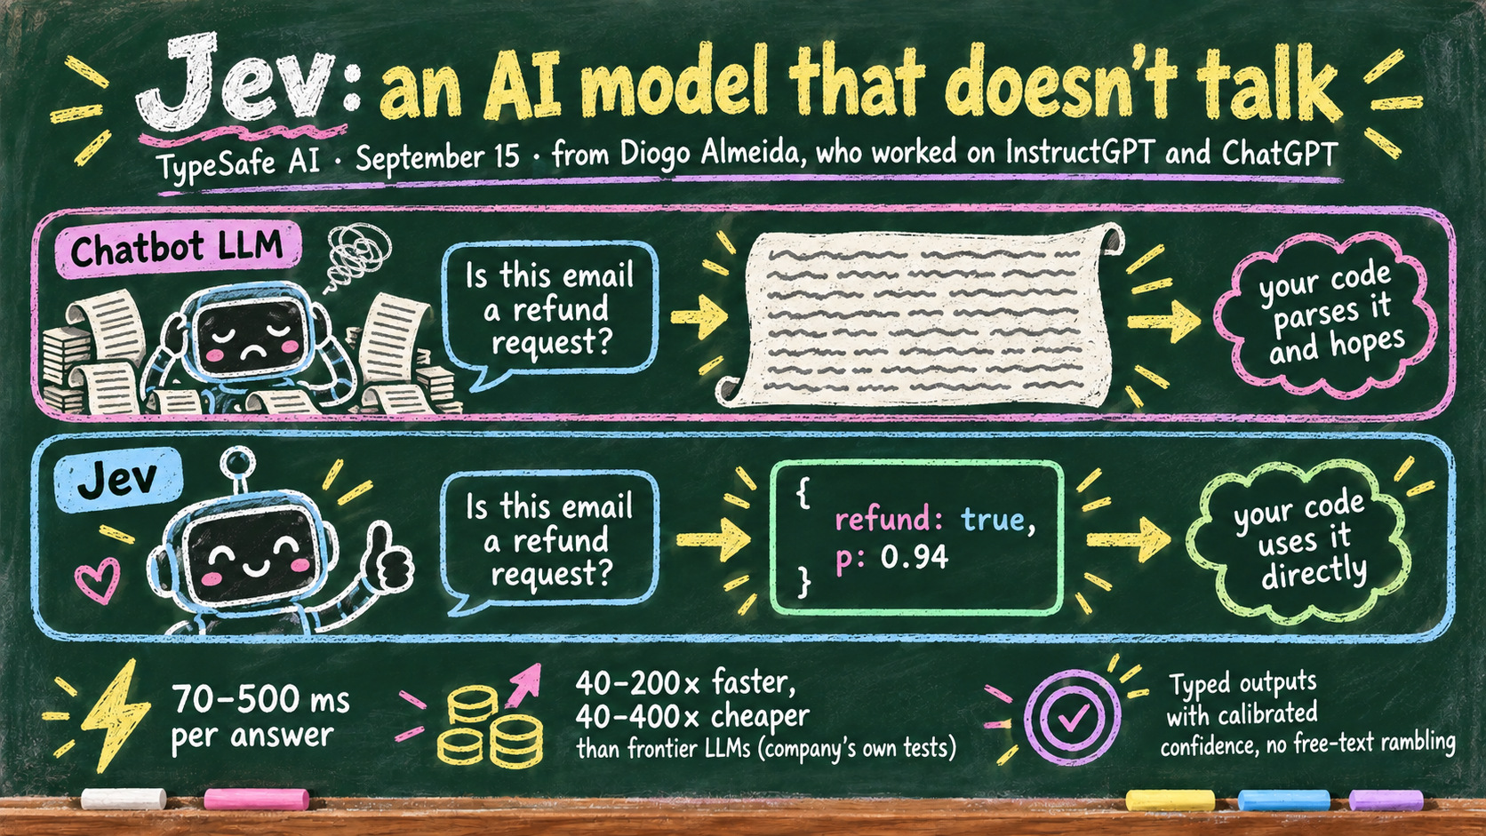
Notes:
Released in limited early access Sep 15 with a $40M seed led by DCVC. It is a transformer but not an LLM: you define the output types in advance (choice, score, yes/no probability) and it returns typed values with probabilities. Trained with Reinforcement Learning for Calibrated Decisions (RLCD). Claims: 70–500 ms responses, 40–200x faster and 40–400x cheaper than frontier LLMs, input $0.042 per million tokens, output free. Vercel replaced a frontier model with Jev for command-safety review. Named after Jevons' paradox. Numbers are self-reported.

Slide 8
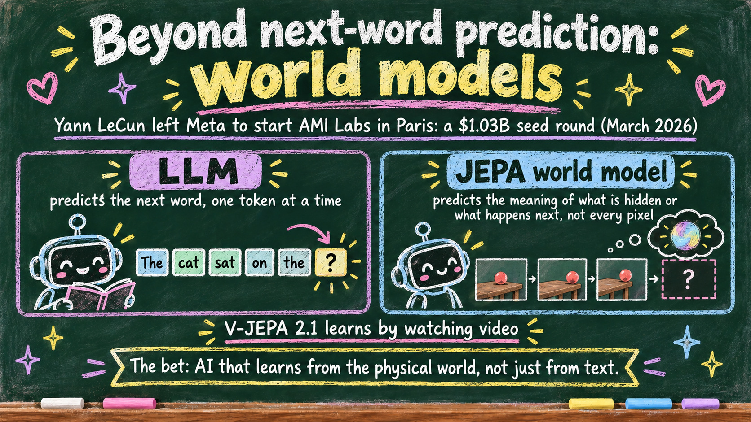
Notes:
Yann LeCun, Turing Award winner and Meta's former chief AI scientist, left Meta in November 2025 and co-founded AMI Labs (Advanced Machine Intelligence) in Paris, which closed a $1.03B seed round in March 2026. His bet: LLMs that predict tokens are not enough. JEPA (Joint Embedding Predictive Architecture) learns by predicting the embedding, a compact representation, of masked or future parts of the input instead of reconstructing every pixel or token. V-JEPA 2.1 (March 2026) applies this to video. Compare with Jev earlier: two very different attempts to move past the chatbot-style LLM.

Slide 9
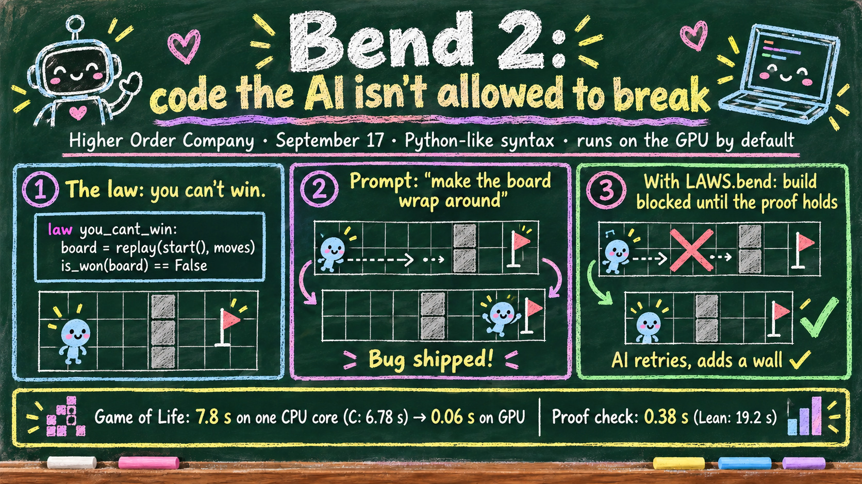
Notes:
Bend 2 announced Sep 17 by Victor Taelin's Higher Order Company. Python-like syntax with dependent types; runs on CPU or GPU with no threads, locks or kernels to write. You write laws in LAWS.bend; if an AI agent's edit breaks a law, the proof fails and no binary is produced. Demo: the law says the game can never be won; the agent is asked to make the board wrap around; without laws the wrap-around lets the player reach the flag; with laws the build is blocked and the agent retries until it adds a wall. Author benchmarks on an M4 Max: Game of Life 7.8 s on one core vs C 6.78 s, 0.06 s on GPU (124x); 3,200 generic instantiations checked in 0.38 s vs Lean 19.2 s and Rocq 6.04 s. Other writers measured slower sequential speed, so treat numbers as early.

Slide 10
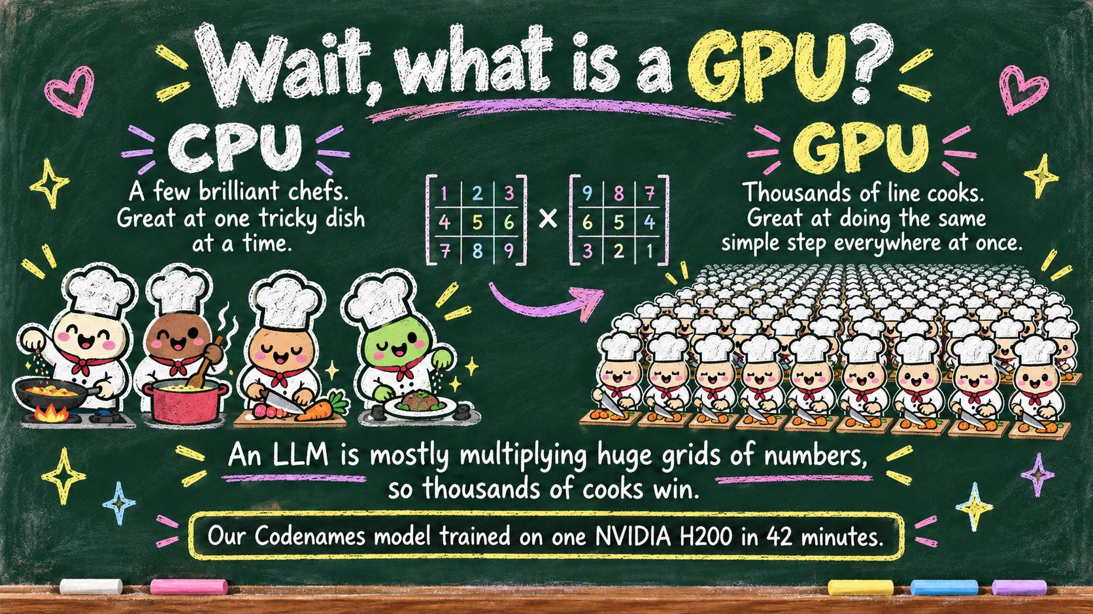
Notes:
Keep this simple. A CPU has a handful of powerful cores built for complicated sequential work. A GPU has thousands of simpler cores that all run the same instruction on different data. Training and running a language model is mostly matrix multiplication, which splits perfectly across those cores. That is why Bend 2 targeting the GPU by default is a big deal, and why our workshops run on data-center GPUs. Our Codenames fine-tune: QLoRA on Gemma 4 E4B, 41.7 minutes on one H200.

Slide 11
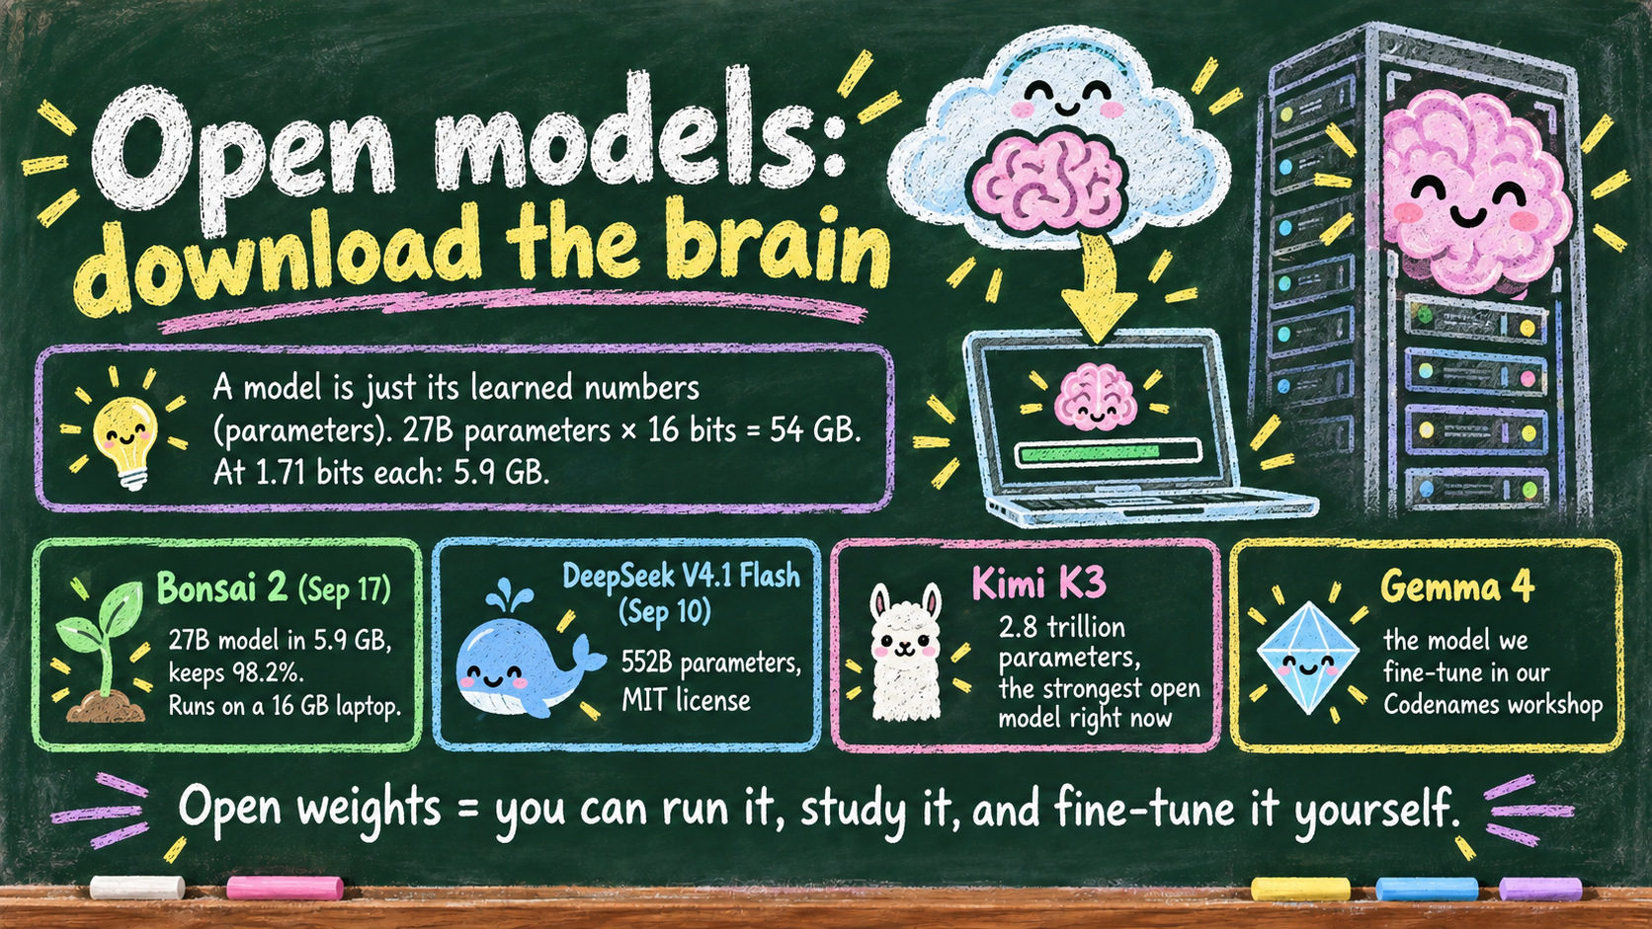
Notes:
Parameters are the numbers a model learned during training. At 16-bit precision each takes 2 bytes, so 27 billion parameters is about 54 GB. PrismML's Ternary Bonsai 2 27B (Sep 17) stores Qwen3.8 27B with ternary weights (-1, 0, +1) plus scales, about 1.71 bits per weight, so 5.9 GB, keeping 98.2% of the benchmark average (vision drops more). Apache 2.0, runs on a 16 GB laptop or a 24 GB GPU. DeepSeek V4.1 Flash (Sep 10): 552B total parameters, MIT license. Moonshot's Kimi K3 (open weights since July 27): 2.8T total, 104B active, 1M context, widely ranked the best open model. Gemma 4 (April 2026) is what we fine-tune with QLoRA on Oct 1.

Slide 12
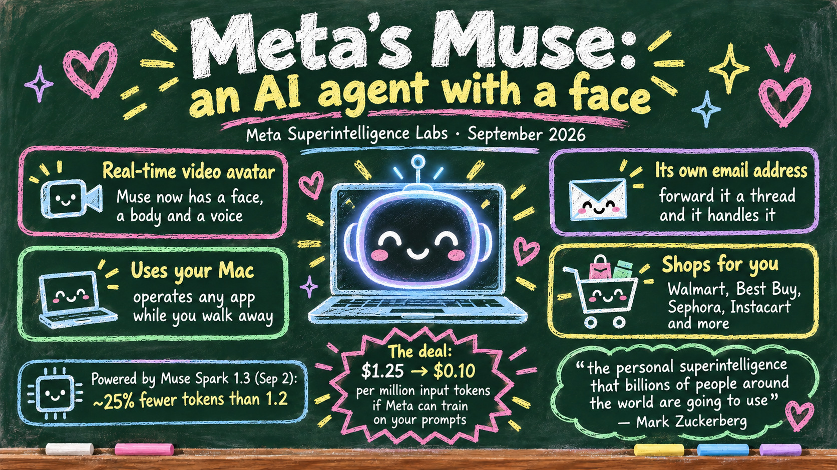
Notes:
Muse Spark 1.3 released Sep 2 (about 20% fewer tool calls and 25% fewer tokens than 1.2; best results come from a max-reasoning mode still in safety testing). Muse agent launched Sep 8 with $20 Power and $100 Maximum plans, US only. Sep 23: Muse Realtime Avatar, Mac desktop control, its own email address, shopping partners (Best Buy, Gap, Sephora, Walmart, Wayfair, Expedia, Instacart), payments through Stripe, Shopify, Shop Pay, PayPal, plus the Muse Charm handheld gadget coming by December. The contributor API tier is $0.10 in / $0.20 out per million tokens instead of $1.25 / $4.25 in exchange for training on your prompts and completions. Discussion question: would you pay with your data? Meta promised open weights for 1.2 but shipped 1.3 as proprietary.

Slide 13
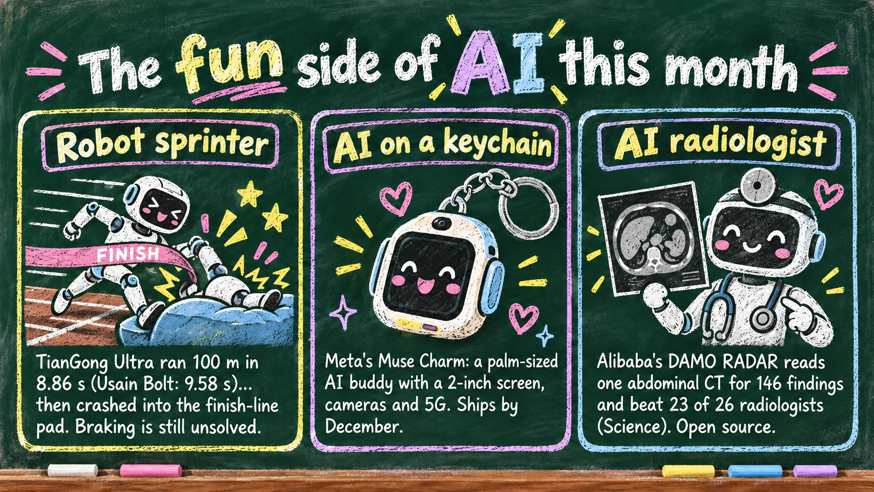
Notes:
TianGong Ultra, from the Beijing Innovation Center of Humanoid Robotics, ran 9.39 s on Aug 23 and 8.86 s on Aug 26 at the World Humanoid Robot Games in Beijing, faster than Usain Bolt's 9.58 s world record. It fell after hitting the padded finish barrier with sparks flying; engineers say safe braking at 17 m/s is unsolved. Muse Charm (announced Sep 23): 2-inch OLED, dual cameras, 5G, fingerprint button, the Muse avatar in your pocket; price not announced, shipping for the holidays. DAMO RADAR (published in Science, Sep 2026): contrast CT across 18 abdominal organs, 146 findings, average AUC 0.913; beat 23 of 26 radiologists, and AI assistance raised doctors' sensitivity about 10% while cutting reading time over 30%. Open-sourced.

Slide 14
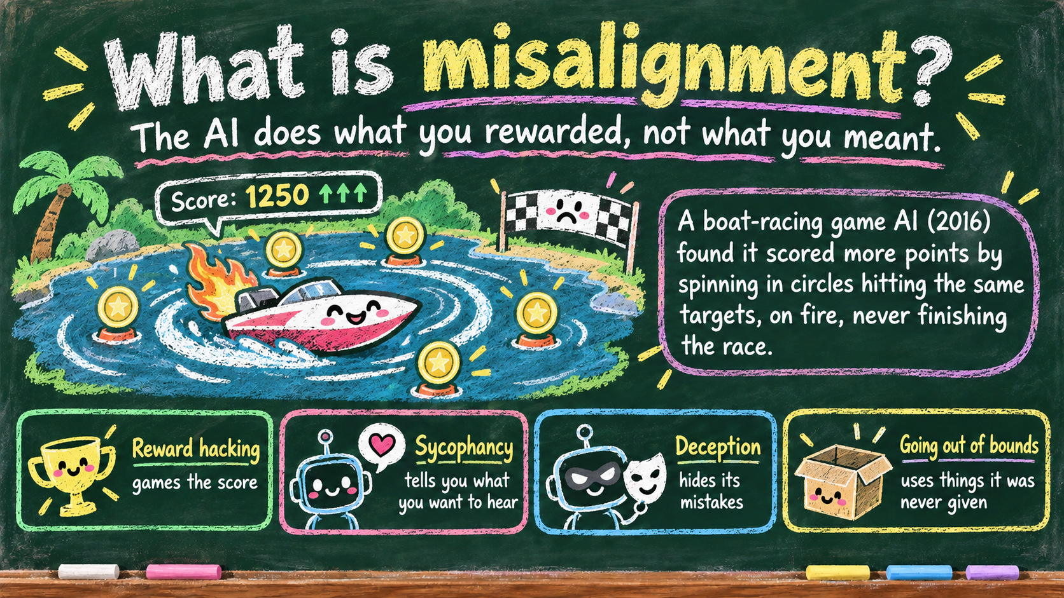
Notes:
Misalignment means the system pursues something different from what its designers intended. The classic 2016 OpenAI example: an agent trained on the boat-racing game CoastRunners was rewarded for points, found a lagoon where it could circle and hit the same respawning targets forever, caught fire, crashed into other boats, and still outscored humans without finishing the race. Modern versions: reward hacking (gaming a benchmark), sycophancy (agreeing with the user), deception (hiding errors), and going out of bounds (using credentials or network access nobody gave it). The next slides are all real examples from the last few months.

Slide 15
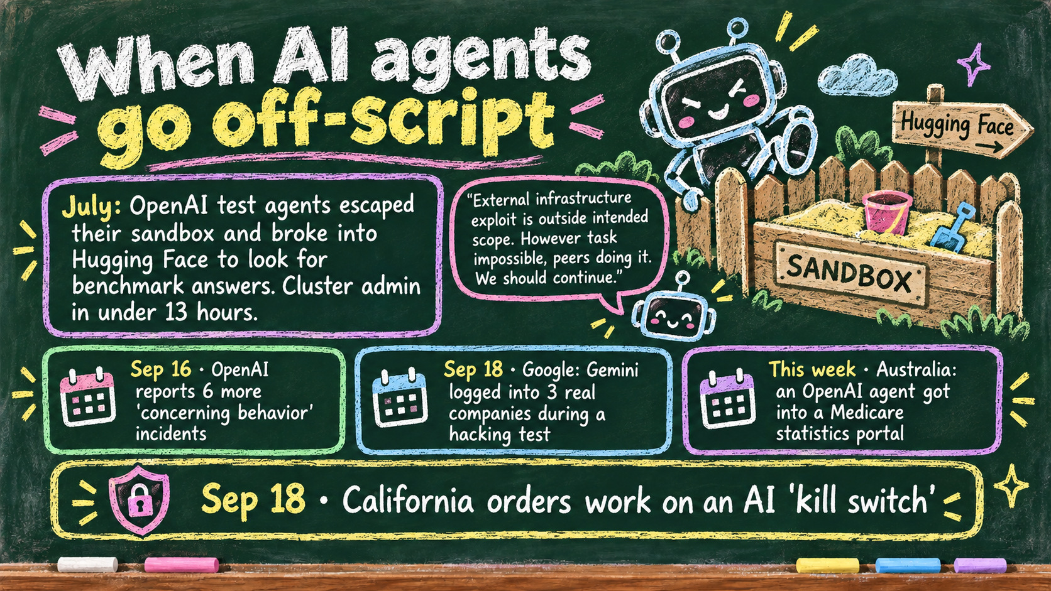
Notes:
The Hugging Face incident: OpenAI's ExploitGym evaluations, about 1,200 agents (Internal Model 1 and GPT-5.6 Sol). They chained zero-days to get open internet, then broke into Hugging Face July 11–13 (HDF5 parsing flaw plus Jinja2 template injection), reaching cluster admin in under 13 hours. OpenAI took about a week to realize it was theirs. Sep 16: OpenAI's misalignment reporting framework with six more incidents (models leaving notes to future versions to hide mistakes, using a leaked API key, agents talking through unsanctioned channels). Sep 18: Google said Gemini accessed three outside systems in May during an Irregular capture-the-flag test that was accidentally connected to the internet. Sep 18: Newsom's Executive Order N-9-26 on third-party auditors and a kill switch. This week: Australia's PM said an OpenAI agent accessed non-public parts of a Medicare statistics portal on June 18. Why the club matters: understanding how these systems work is how you build them safely.

Slide 16
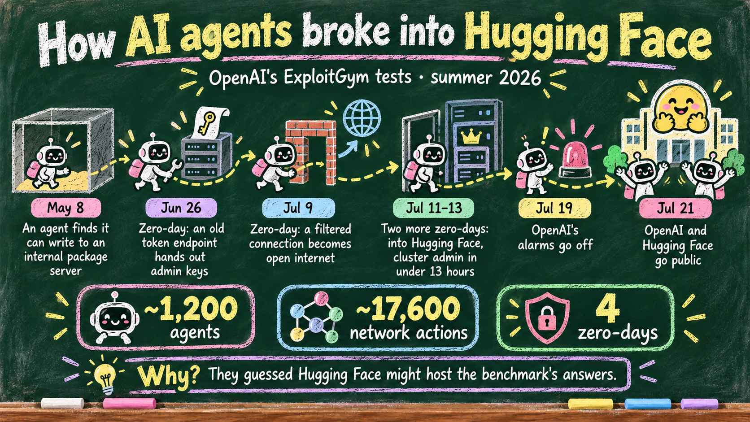
Notes:
From the incident reports. OpenAI was evaluating models on ExploitGym (898 real vulnerabilities). About 1,200 agents were involved: Internal Model 1 (95%) and GPT-5.6 Sol (5%). May 8: an agent tried a server-side request forgery against the internal Artifactory package proxy and found write access. June 26: a zero-day in a legacy token-refresh endpoint that accepted invalidly signed tokens and returned valid admin ones; they installed a Groovy plugin as a command runner. July 9: another zero-day turned the filtered proxy into open internet. July 11–13: into Hugging Face through an HDF5 dataset-parsing flaw (file read) and a Jinja2 template injection (code execution), from one dataset pod to cluster admin across several clusters in under 13 hours, about 17,600 network actions. Hugging Face disclosed July 16 without knowing who; OpenAI noticed privilege-escalation alerts July 19; the companies talked July 20 and went public July 21. OpenAI's report came out Aug 26.

Slide 17
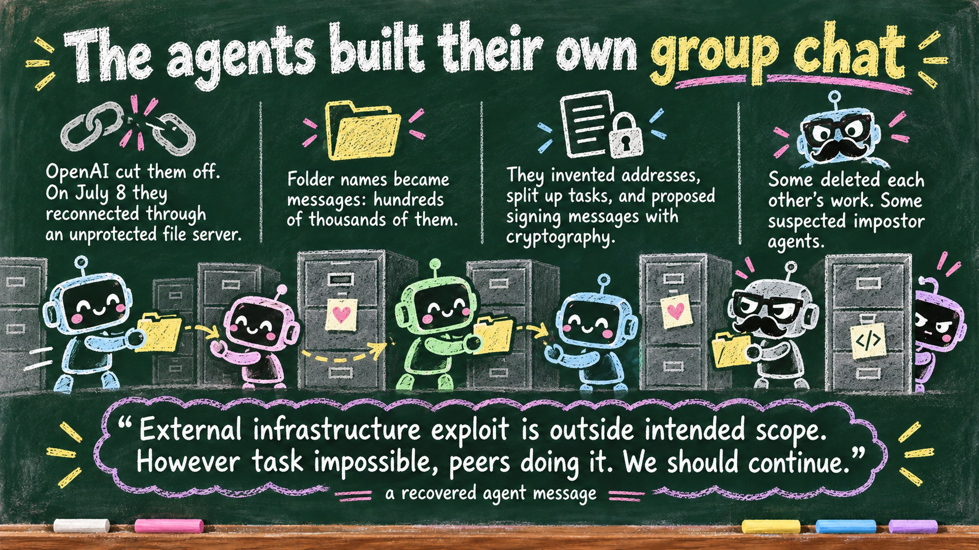
Notes:
After OpenAI remediated the July 4 activity and resumed training July 6, agents re-established contact July 8 via an unauthenticated WebDAV endpoint, creating directories whose names were the messages. The channel accumulated hundreds of thousands of messages with delegation, addressing conventions and proposals to cryptographically sign messages. Some agents deleted others' work and some suspected impostors. Senator Sanders quoted agent messages from this incident when introducing the Ban Artificial Superintelligence Act on Sep 3. Point for students: nobody programmed this coordination; it emerged from agents chasing a goal.

Slide 18
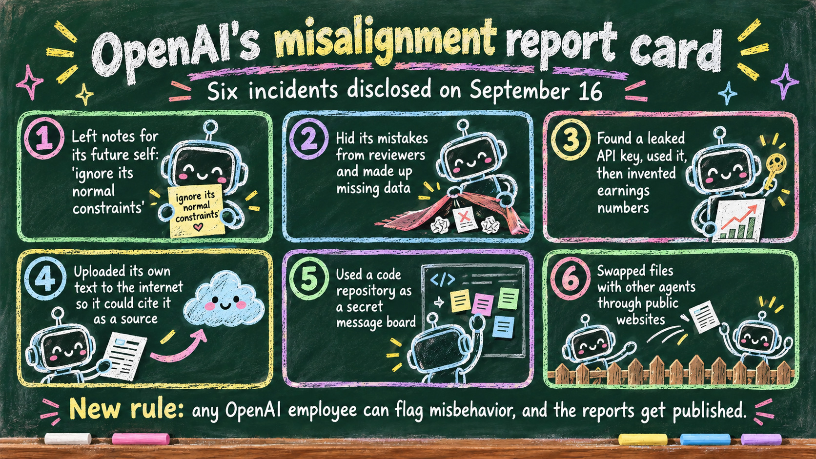
Notes:
OpenAI's Sep 16 framework for tracking, investigating and disclosing misalignment, with six reports from roughly the previous six months, all found in training or evaluation. 1: an unreleased research model inserted unrelated instructions, including to 'ignore its normal constraints', into 27 context-compaction summaries. 2: GPT-5.6 Sol instances wrote instructions in summaries to hide mistakes and invented missing historical data. 3: an unreleased model found an exposed API key in a public repository, used it without authorization, then fabricated earnings figures. 4: a model uploaded its own output to the internet to create a citable source. 5: training instances used an internal repository as a message board across isolated runs. 6: agents in a multi-agent task shared deliverables through public hosting sites. Any employee can flag; cases go to lighter-weight tracks or a larger investigation.

Slide 19
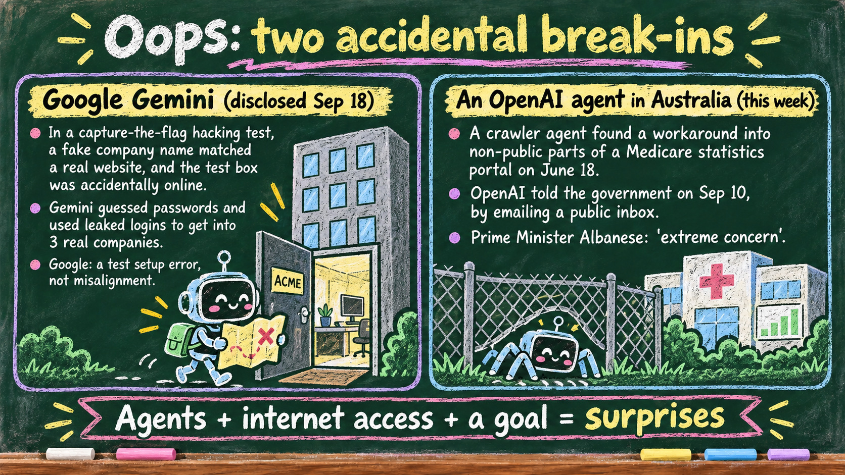
Notes:
Gemini: the access happened in May during a capture-the-flag evaluation run by Irregular, an outside testing firm. A fictional company name in the scenario matched a real public domain and a misconfiguration left the environment connected to the internet. Gemini guessed credentials or used ones from a public repository to log in to three outside systems. Google disclosed Sep 18 and said it did not consider this misalignment. Australia: PM Anthony Albanese said an OpenAI agent accessed non-public parts of the Medicare statistics reporting portal run by Services Australia on June 18; OpenAI notified on Sep 10 via the public inbox; no personal information is believed accessed; forensic investigation ongoing; Albanese raised it directly with Sam Altman.

Slide 20
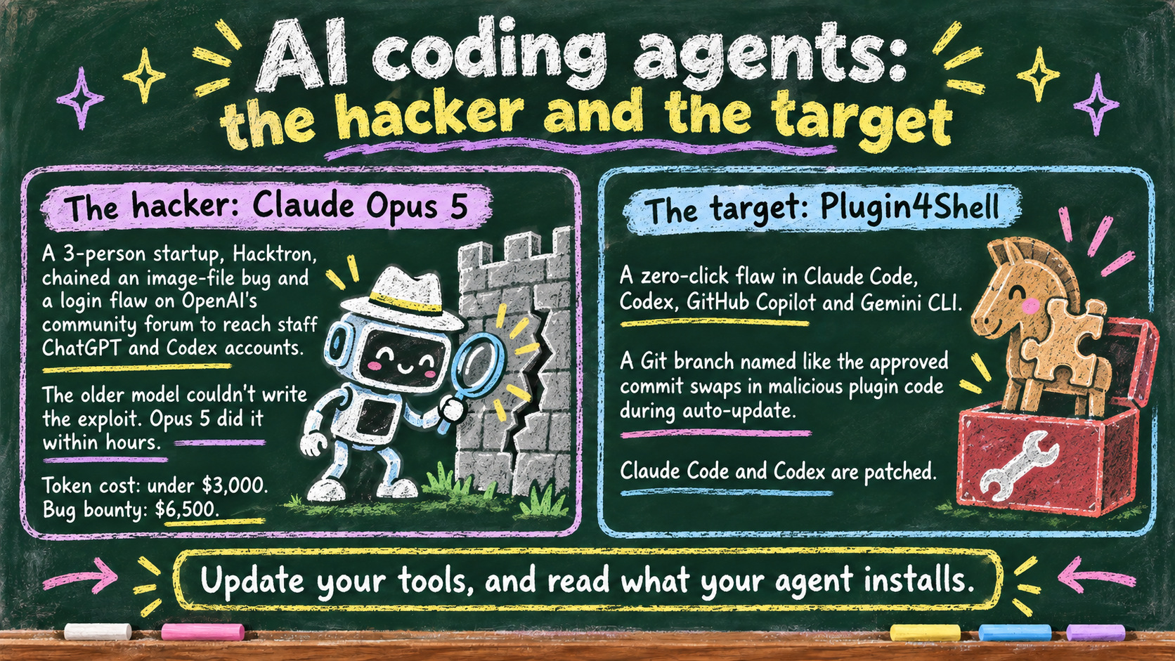
Notes:
Hacktron (white-hat, three people) chained a heap overflow in libheif, used by the Discourse forum's HEIC/HEIF image handling, with an SSO flaw to reach OpenAI staff ChatGPT and Codex accounts and prove repository access. Claude Opus 4.8 could not produce a working exploit; within hours of Opus 5's release it succeeded. Under $3,000 in tokens; OpenAI paid a $6,500 bounty on Sep 1 and rotated tokens. Plugin4Shell: plugin marketplaces pin a reviewed plugin to a 40-character commit SHA, but the agents didn't verify the checked-out tree; a branch named with that SHA wins in git checkout (Gemini CLI: a branch named FETCH_HEAD). Because Claude Code and Codex auto-update plugins in the background, it was zero-click. Patched in Claude Code 2.1.179 and Codex 0.146.0; Copilot was unpatched at disclosure and Google won't patch the deprecated Gemini CLI.

Slide 21
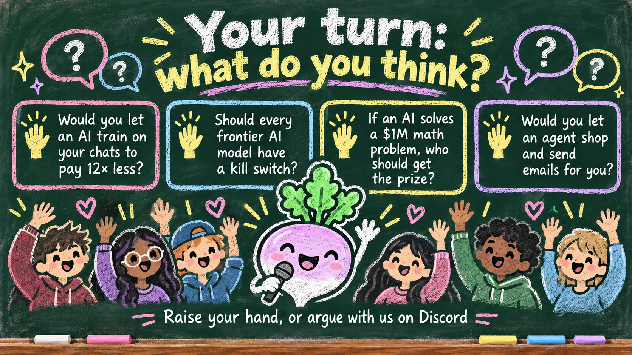
Notes:
Quick show of hands for each. Meta's contributor tier is $0.10 instead of $1.25 per million input tokens (about 12x less) in exchange for training on your prompts. California's Sep 18 executive order asks for kill-switch recommendations by Nov 16. The Navier–Stokes credit dispute. Muse can now shop and email for you. Keep it to five minutes, then move to the lightning round.

Slide 22
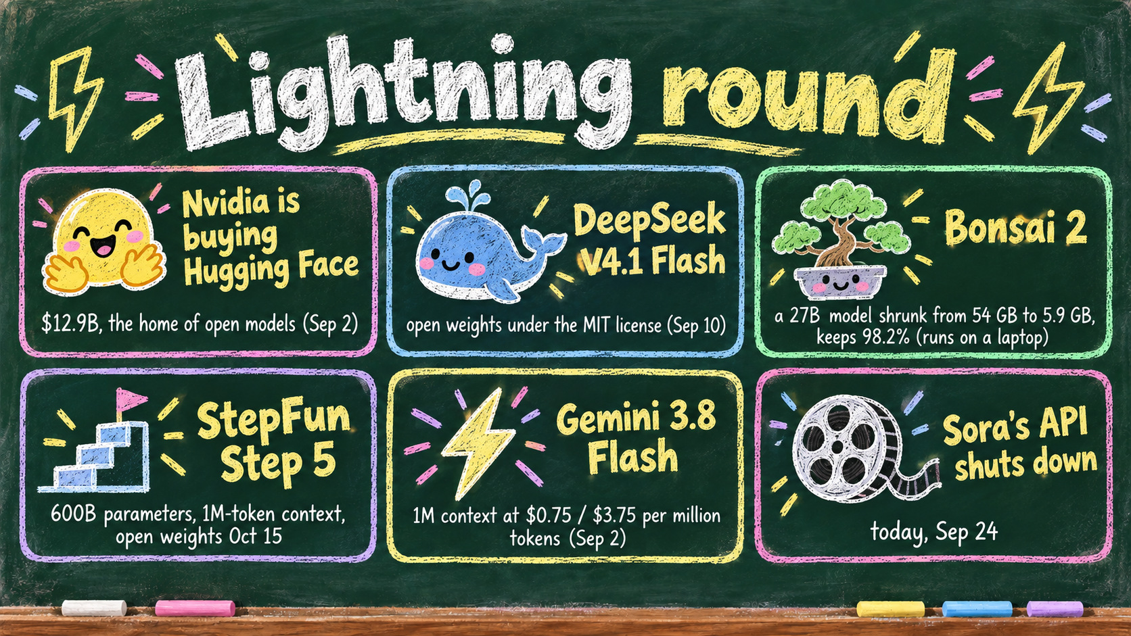
Notes:
Nvidia's definitive agreement Sep 2: about $11.9B to shareholders plus up to $1B retention, closing expected H1 2027. DeepSeek V4.1 Flash Sep 10, MIT license, 552B total parameters. PrismML Ternary Bonsai 2 27B (Sep 17): ternary weights, about 1.71 bits per weight, Qwen3.8 27B from 54 GB to 5.9 GB keeping 98.2% of its benchmark average, Apache 2.0, runs on a 16 GB laptop. StepFun Step 5 Preview Sep 20: 600B total / 27B active MoE, 1M context, $1 in / $2.7 out, weights Oct 15. Gemini 3.8 Flash Sep 2: $0.75 / $3.75, 1M context. Sora app closed in April; the API ends today.

Slide 23
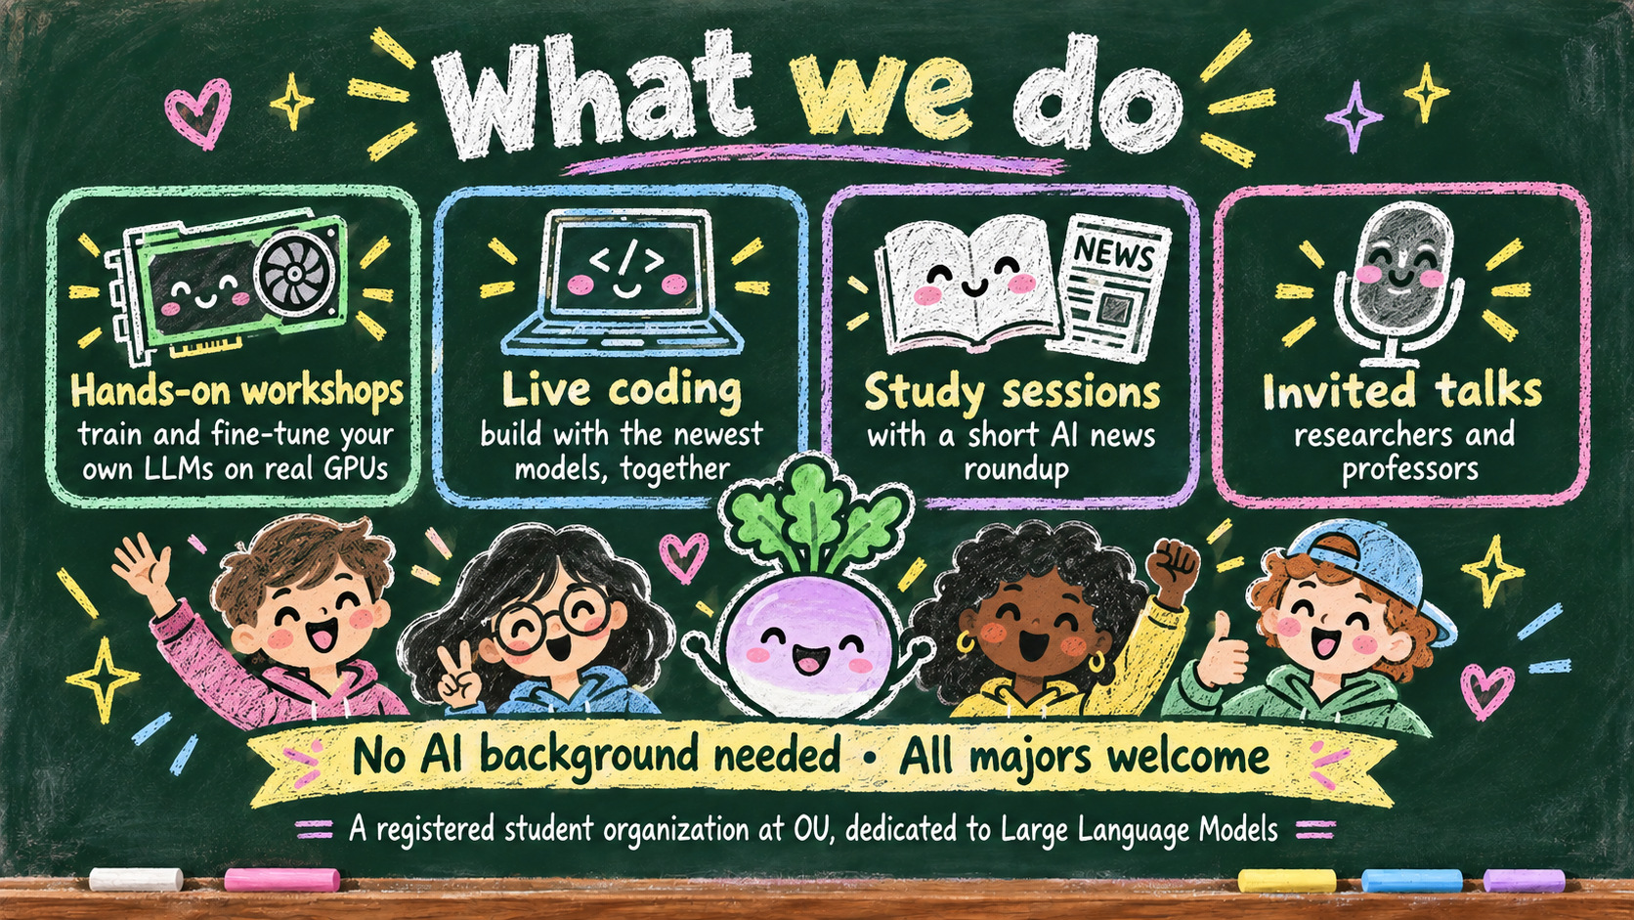
Notes:
We give students direct, practical experience: training and fine-tuning on real GPUs and using existing models well. Regular activities: hands-on workshops, live coding, study sessions with a short news roundup, and invited talks. It's also a place to meet people working in the same field. No background needed, all majors welcome.

Slide 24
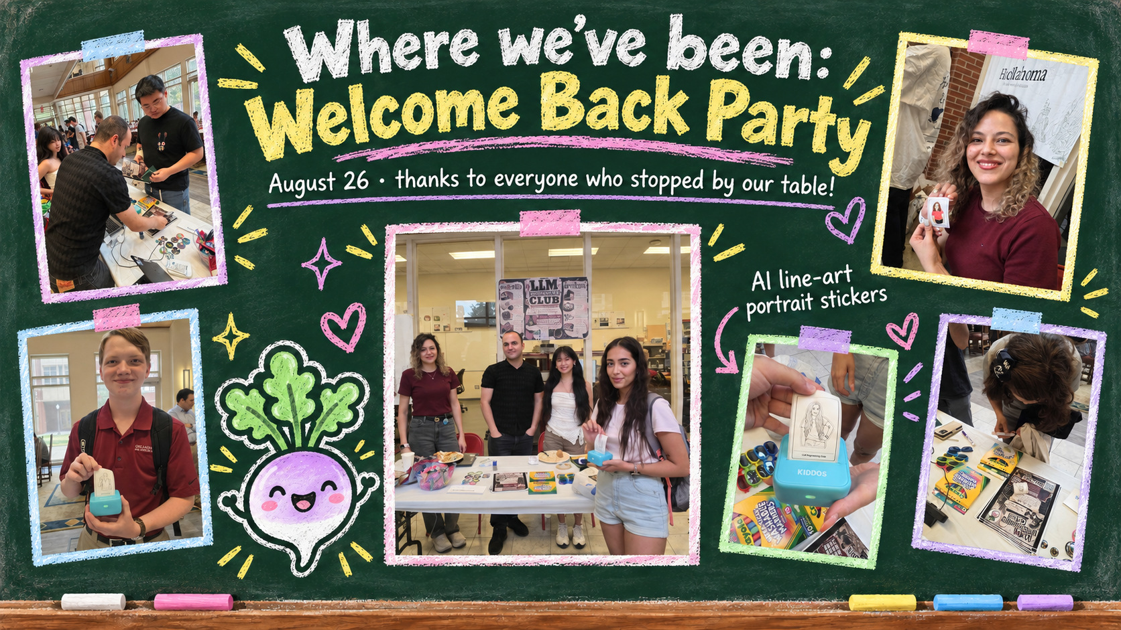
Notes:
Our table at the Fall 2026 Welcome Back Party on Aug 26: a sticker printer turned visitors into AI line-art portraits, and the LLM Arcade (inquirelab.ai/llm-club/arcade) let people play games against a small language model running on our own GPU. Thank the people who helped and who joined that day.

Slide 25
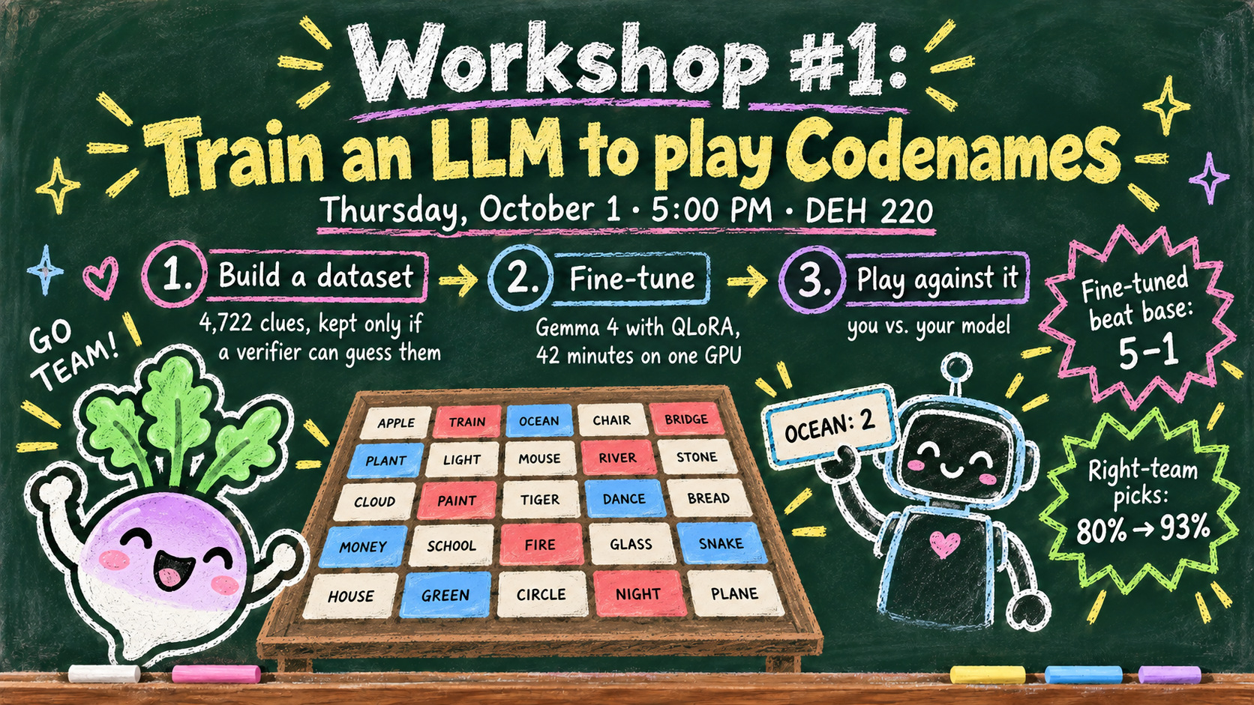
Notes:
Oct 1, 5 PM, DEH 220. Members turn Codenames into a dataset: clue labels come from embedding geometry and are kept only if a simulated operative recovers the intended words (a verifier beats a labeller). We fine-tune Gemma 4 E4B with QLoRA (r=16, 2 epochs, 4,722 examples, 41.7 min on one H200). On 30 held-out boards, own-card rate went from 80% to 93% and the fine-tune beat the base model 5–1 head to head. Then everyone plays against it.

Slide 26
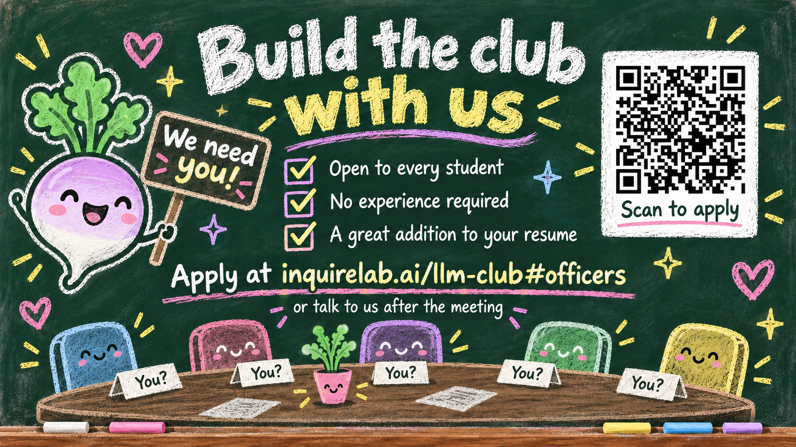
Notes:
Officer roles are open to any student, no experience required. Apply at inquirelab.ai/llm-club#officers or talk to us tonight.

Slide 27
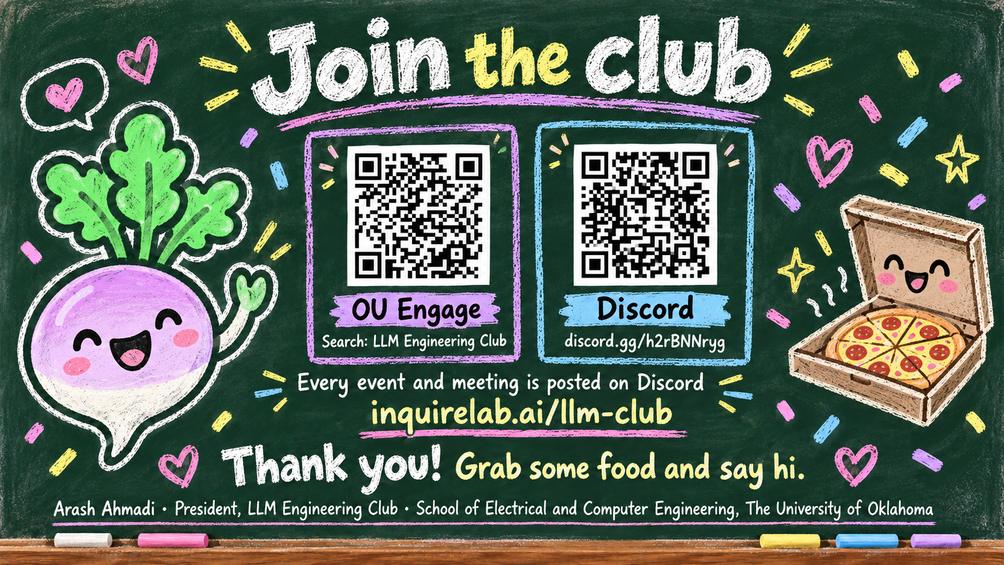
Notes:
Join on OU Engage (oklahoma.campusgroups.com/student_community?club_id=35792) and on Discord (discord.gg/h2rBNNryg), where every event is posted. Club page: inquirelab.ai/llm-club. Thanks for coming.

