Slide 1
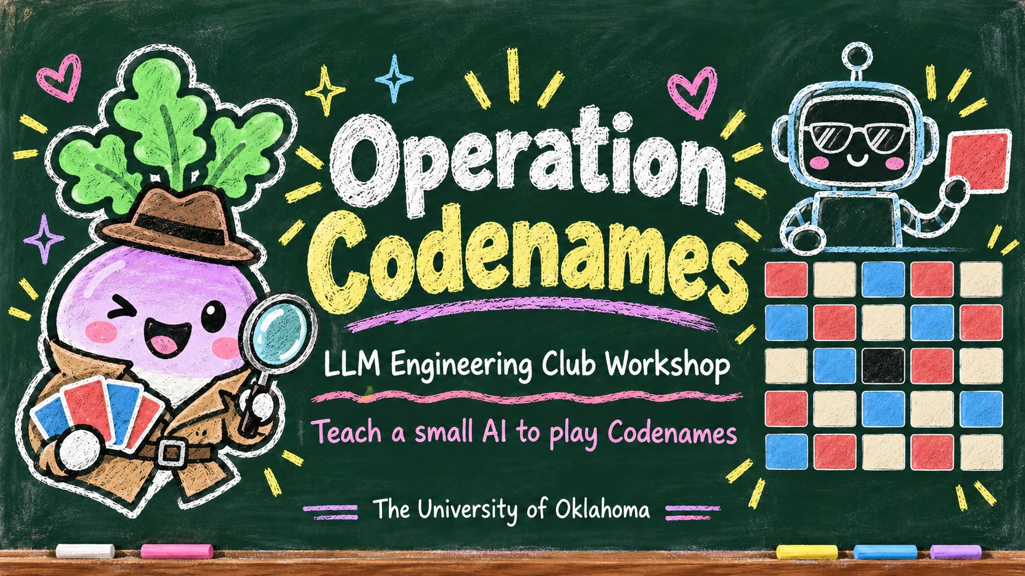
Notes:
Welcome to Operation Codenames! Tonight we teach a small AI to play the word game Codenames, and no AI background is needed. By the end you will have trained your own model and sent your own bot into battle.

Slide 2
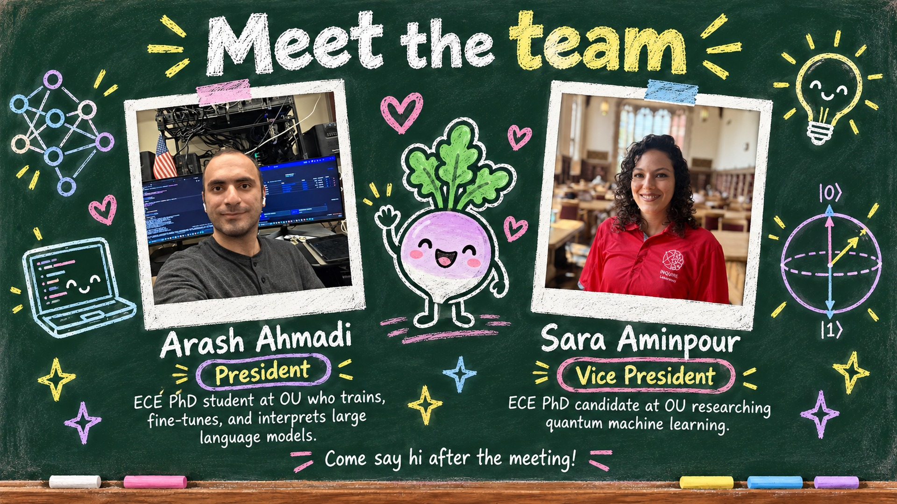
Notes:
Meet the team: I'm Arash Ahmadi, the club president, and this is Sara Aminpour, our vice president. Come say hi after the workshop, we're always happy to talk about LLMs.

Slide 3
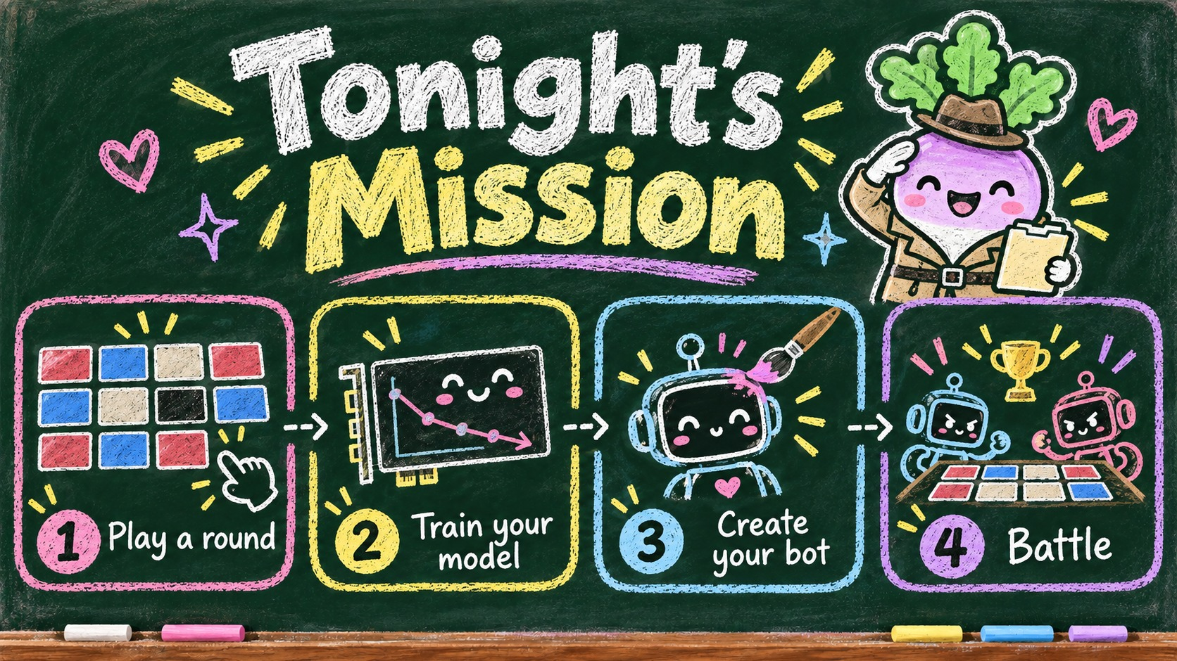
Notes:
Here is the plan for tonight, and it matches the step bar at the top of the portal. First you play a round, then you train your model, then you create your bot, and finally we battle.

Slide 4
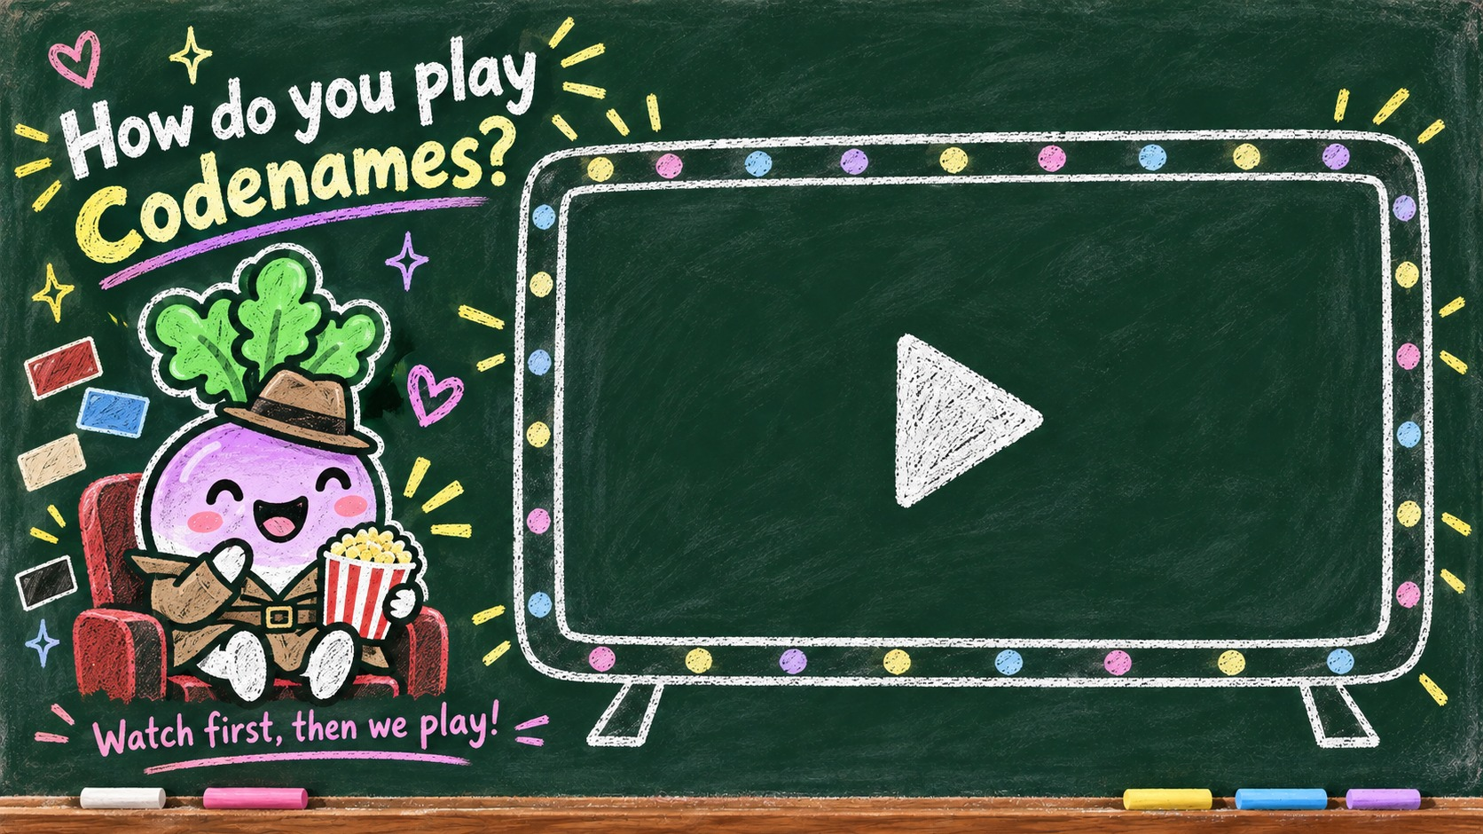

Notes:
Video slide: insert the Codenames explainer video in the placeholder box, then delete the box.
CODENAMES EXPLAINER: NARRATION SCRIPT
(LLM Engineering Club, Operation Codenames workshop, Oct 1 2026)
[Intro]
Psst. Hey, agent.
Your mission today: learn to play Codenames, the party game of secret agents and sneaky one-word clues.
[Teams and roles]
Players split into two teams: Red, and Blue.
Each team picks one Spymaster. Everyone else is a Field Operative.
The Spymasters know who every secret agent is.
The Operatives? They know nothing... yet.
So the Spymaster gives the clues, and the Operatives make the guesses.
[The board]
To start, twenty five word cards are laid out in a five by five grid.
Each word is a codename, and behind every codename hides a secret identity.
[Secret identities]
Nine of them are red agents.
Eight are blue agents.
Seven are innocent bystanders.
And one...
is the assassin.
[The key card]
Only the Spymasters get to see the secret key card. It shows exactly which word is which.
The lights around its edge show who goes first. Here it's Red, so Red has nine agents to find, and Blue has eight.
[Giving a clue]
Teams take turns. On your turn, your Spymaster gives one clue: exactly one word, and one number.
The word connects some of your team's cards. The number says how many.
Red's Spymaster spots two red words: whale, and wave. Both make you think of the ocean.
So the clue is: Ocean. Two.
Hmm. Ship is on the board too, and ship is blue. Risky!
That's why the number matters. It tells the Operatives how many cards to look for.
[Guessing]
Now the Operatives talk it over, then touch one card at a time.
Whale! The Spymaster reveals who it really is... a red agent! A correct guess means you can keep going.
Wave! Another red agent. Two for two!
You must make at least one guess, and you can make up to the number plus one. That bonus guess helps you catch up on old clues.
Red could try ship... but they decide to stop while they're ahead. Smart move.
[Four possible outcomes]
Every time you touch a card, one of four things happens.
Your own agent: great, keep guessing!
An innocent bystander: oops, your turn ends.
The other team's agent: your turn ends, and you just helped them.
The assassin: game over. Your team loses instantly!
[Spymaster rules]
Spymasters have a few rules to follow.
One word only. No sentences.
You can't say a word that's on the board.
Clues are about meaning, not spelling or position. So no, starts with W, and no, top left.
And keep a poker face! No pointing, no winking, and no groaning when your team guesses wrong.
Break a rule, and your turn ends right away.
[Winning]
Teams trade turns until one team finds all of its agents. That team wins!
Even if the other team reveals your last agent by mistake, you still win.
And if anyone touches the assassin, their team loses on the spot.
[Quick recap]
Quick recap!
Spymasters give one word, and one number.
Operatives guess one card at a time.
Find all your agents first.
And never, ever touch the assassin.
[Why Codenames in an LLM club]
So why Codenames, in an LLM club? Because the whole game is about word associations, and that's exactly what language models learn.
Tonight, you'll train a small language model to be the Spymaster. Then, you'll play against it.
Good luck, agents.

Slide 5
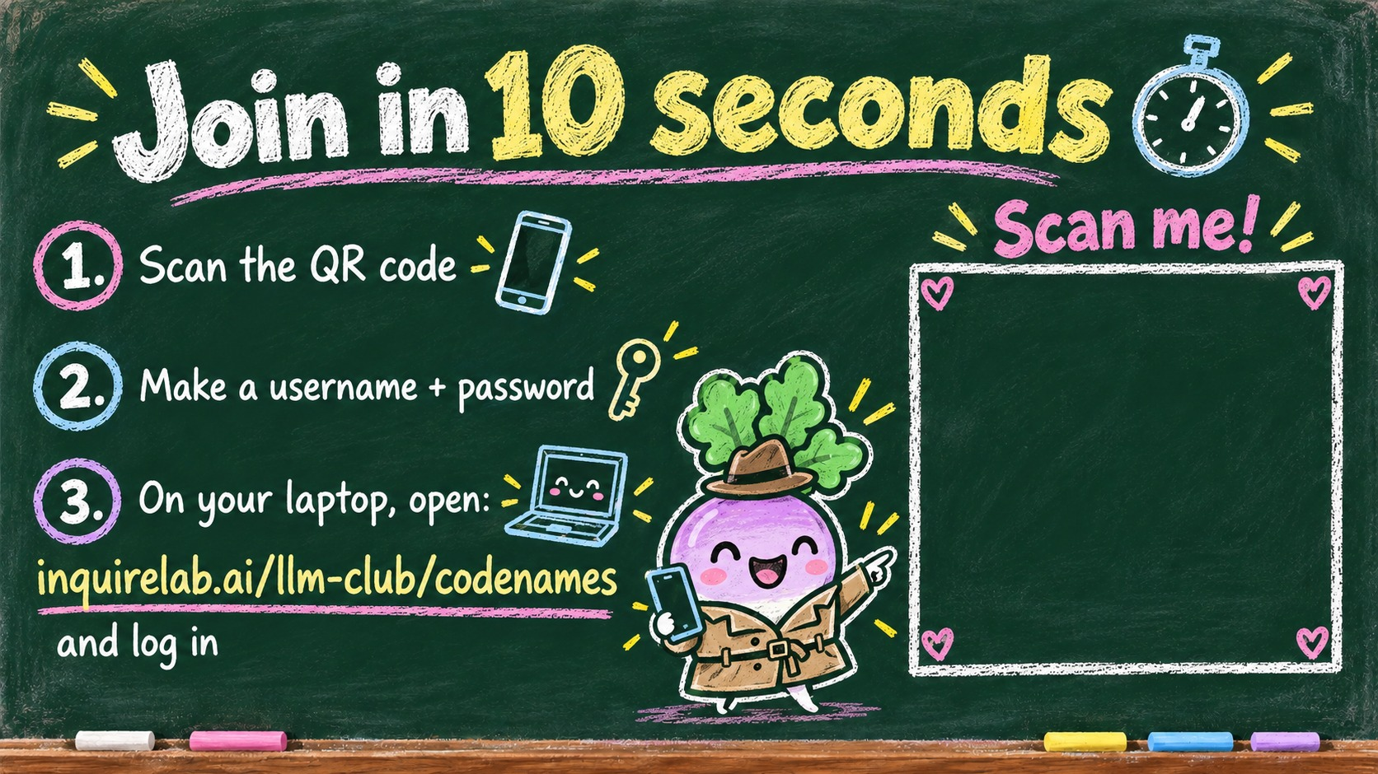

Notes:
Scan the QR code on the screen, make a username and password, and you are in. Then on your laptop open inquirelab.ai/llm-club/codenames and log in with the same account, so you have a big screen for training.

Slide 6
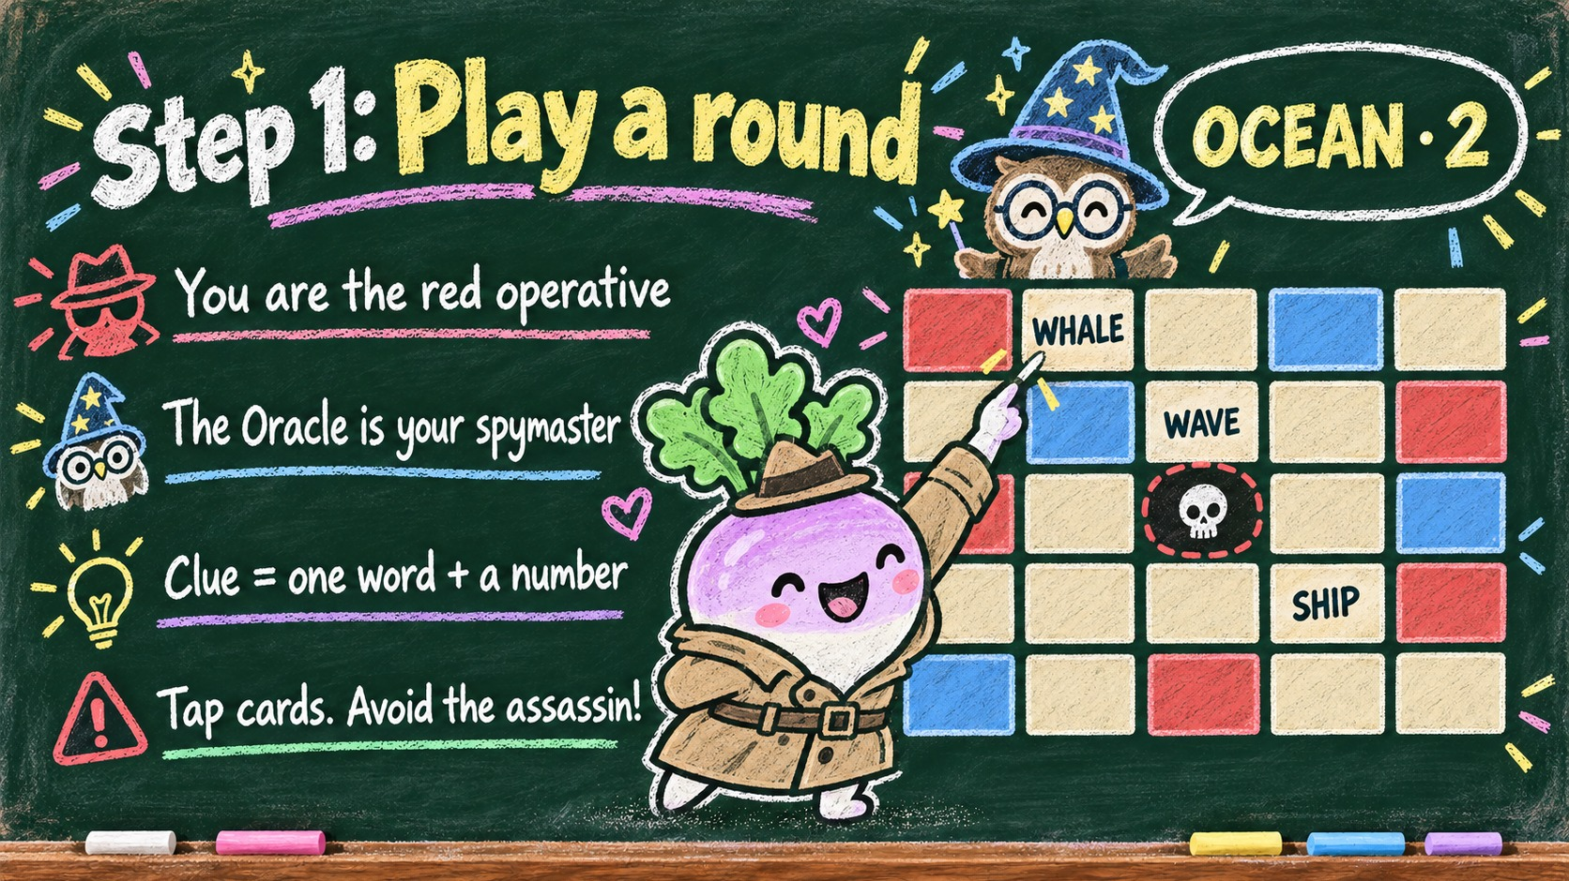
Notes:
Step one: you are the red operative and the Oracle is your spymaster. It gives a clue that is one word plus a number, like OCEAN 2, and you tap the cards you think it means. Whatever you do, avoid the assassin.

Slide 7
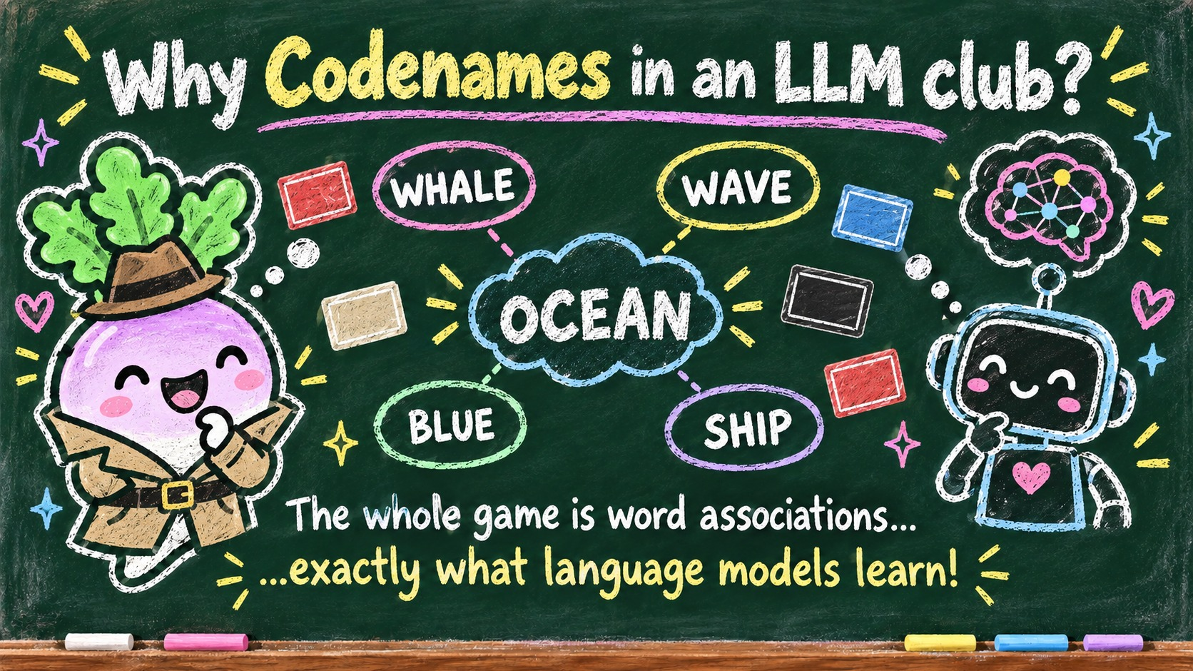
Notes:
Why Codenames in an LLM club? Because the whole game is about word associations, and that is exactly what language models learn from text. A good clue is just a word that sits close to your cards and far from everything else.

Slide 8
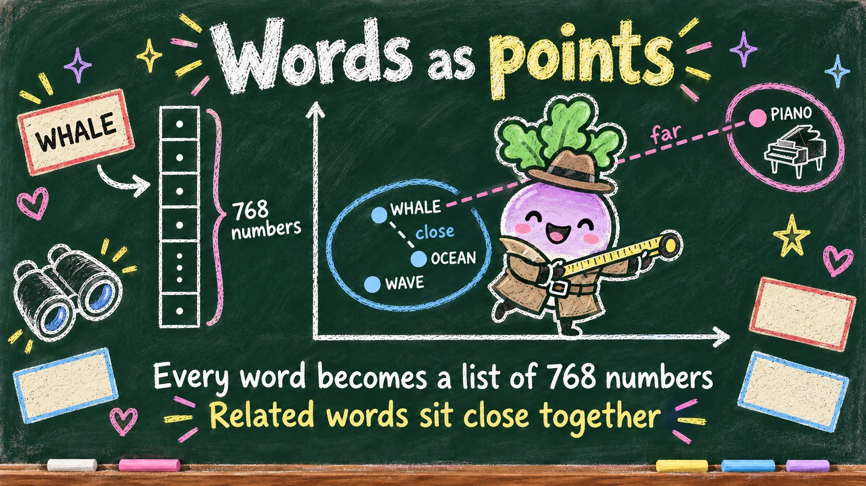
Notes:
Computers cannot compare words directly, so every word becomes a list of 768 numbers, an embedding. Related words end up close together: WHALE sits near OCEAN and far away from PIANO.

Slide 9
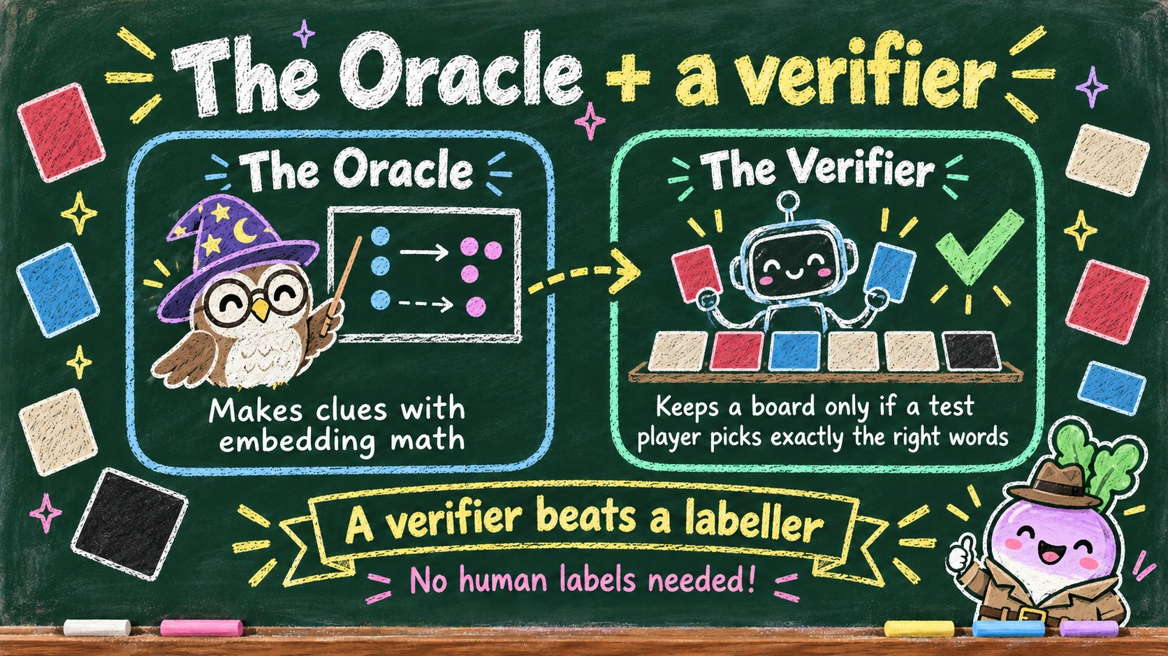
Notes:
The Oracle is a clue generator built from that embedding math. A verifier then plays the board with a simulated player and keeps it only if the player picks exactly the intended words. A verifier beats a labeller: we get clean training data without any human labels.

Slide 10
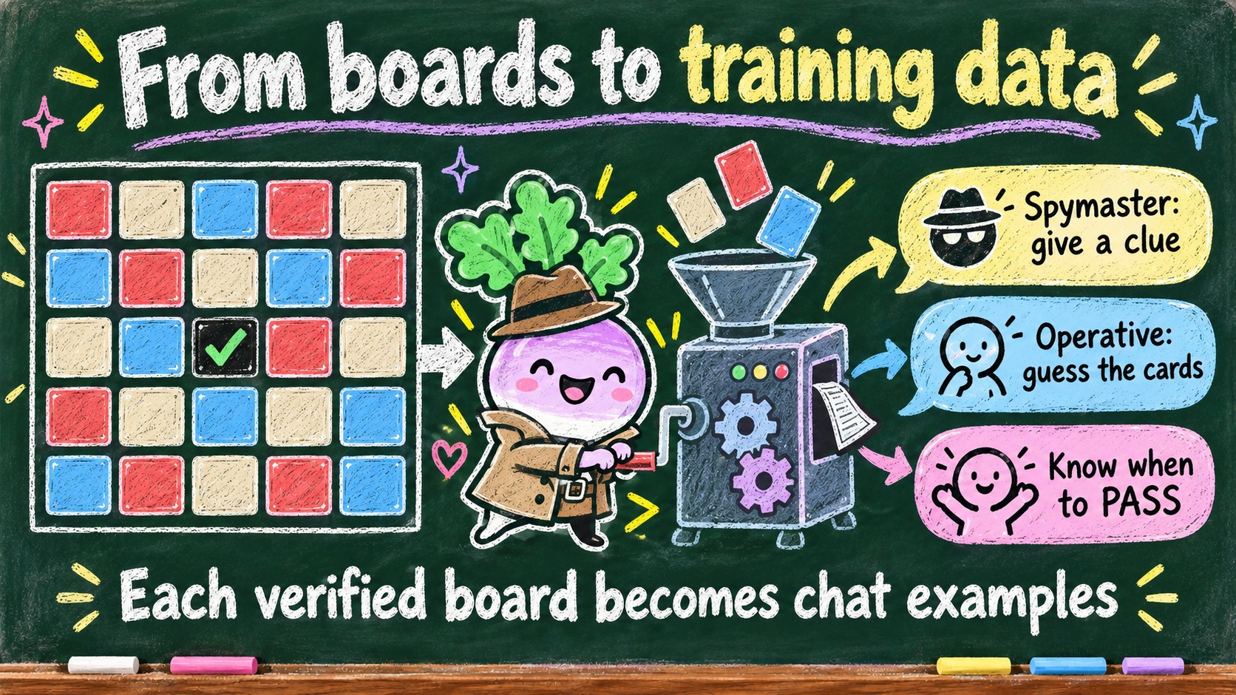
Notes:
Each verified board becomes a few chat examples: the spymaster giving the clue, the operative making the guesses, and the operative knowing when to PASS. That is the dataset your model learns from tonight.

Slide 11
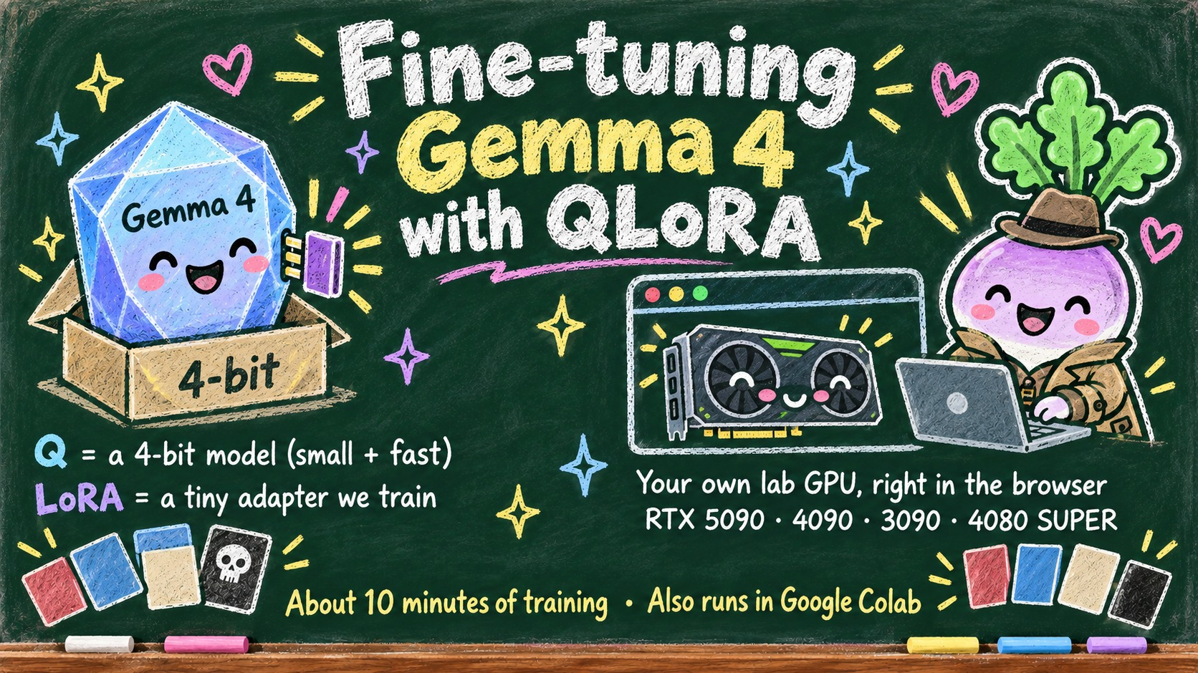
Notes:
We fine-tune Gemma 4 with QLoRA. The Q means the big model is loaded in 4-bit so it fits, and LoRA means we only train a small adapter on top. Everyone gets their own lab GPU right in the browser, training takes about ten minutes, and the same notebook also runs in Google Colab.

Slide 12
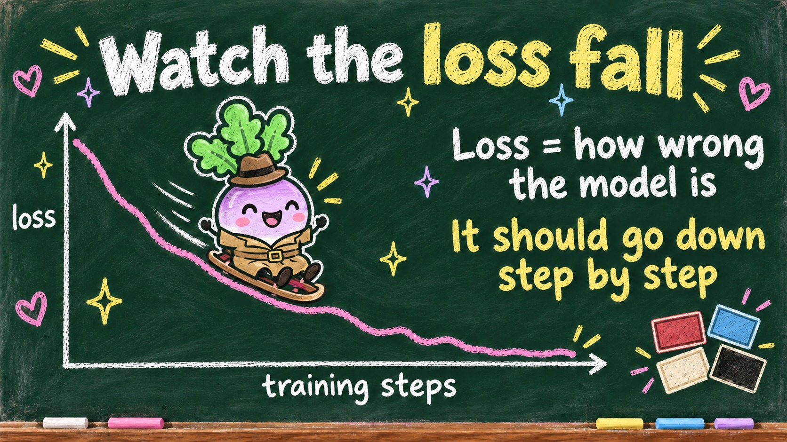
Notes:
While it trains, watch the loss. Loss is simply how wrong the model is on the training examples, so it should go down step by step. A little wobble is normal; a steady downward trend means it is learning.

Slide 13
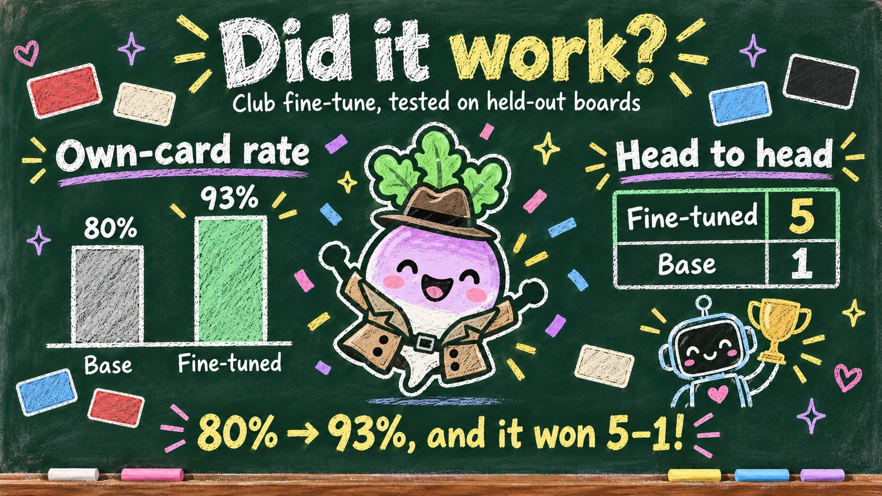
Notes:
Did it work? On held-out boards the club fine-tune picked its own cards 93 percent of the time, up from 80 percent for the base model. Head to head, the fine-tuned model beat the base model 5 to 1.

Slide 14
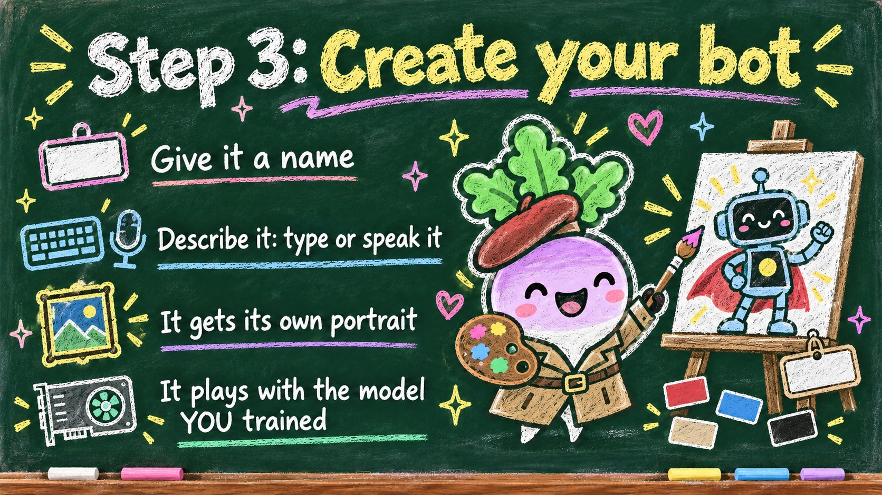
Notes:
Step three: create your bot. Give it a name and describe it, by typing or just speaking, and it gets its own portrait. Most importantly, it plays with the model you just trained.

Slide 15
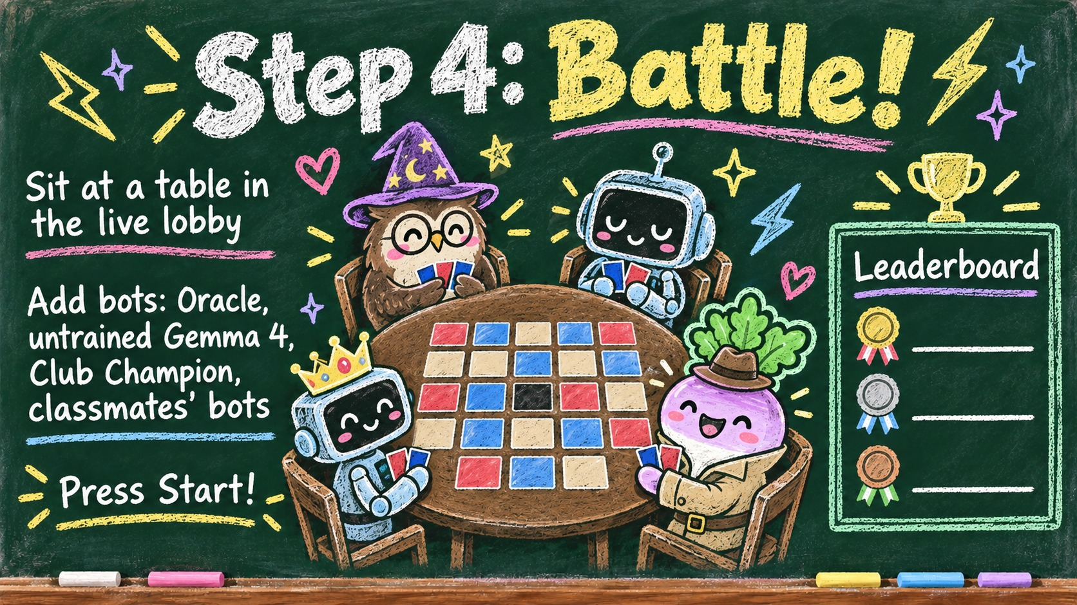
Notes:
Step four: battle! There is one live lobby: sit at a table, add bots like the Oracle, untrained Gemma 4, the Club Champion, or your classmates' bots, and press Start. Student bots climb the leaderboard, so let's see whose model is best.

Slide 16
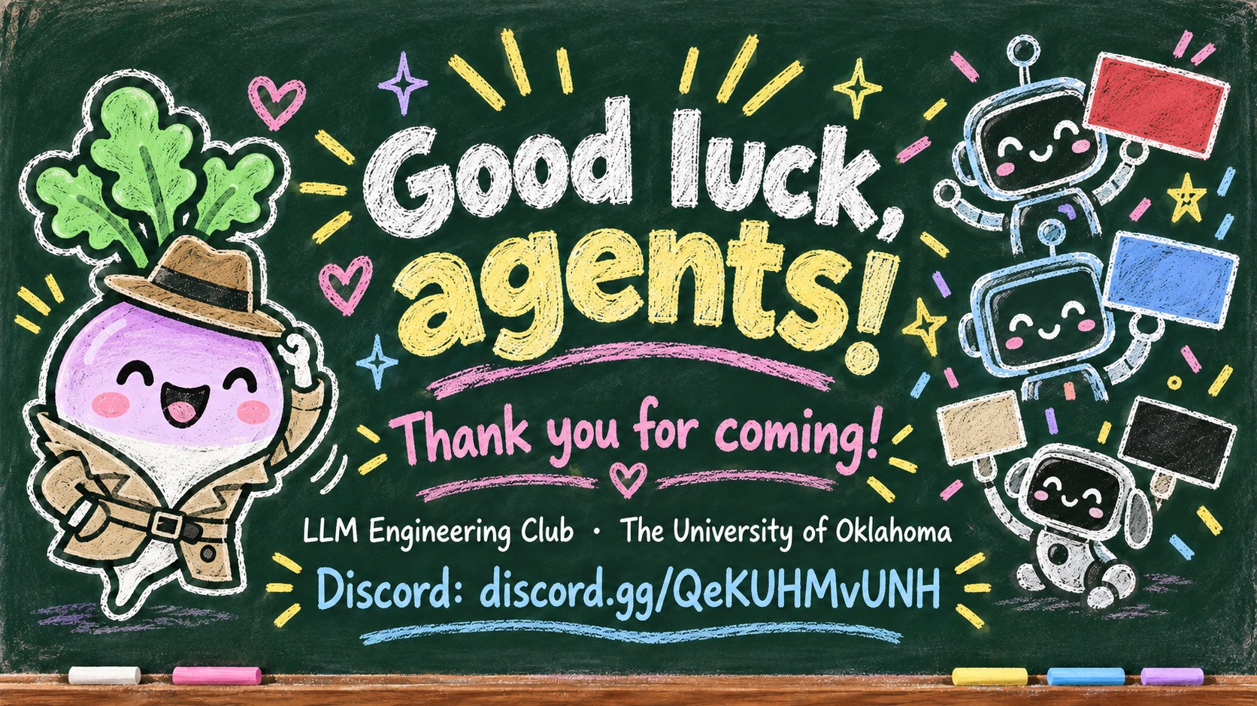
Notes:
Thank you all for coming, and good luck, agents! Join our Discord at discord.gg/QeKUHMvUNH for slides, results and the next events.

